Slide 1
Data Structure and Algorithm Analysis in C++ 数据结构与算法分析（C++）
SONG Shuang
宋霜

Slide 2
Table of Content
Lectrure1: Introduction | Lecture 9: Graph (2)
Lectrure2: Overview of C++ | Lecture 10: Hashing
Lecture3: Algorithm Analysis | Lecture 11: Sorting (1)
Lecture 4: Linear Structure (1) | Lecture 12: Sorting (2)
Lecture 5: Linear Structure (2) | Lecture 13: Greedy Algorithms
Lecture 6: Tree (1) | Lecture 14: Divide and Conquer
Lecture 7: Tree (2) | Lecture 15: Dynamic Programming
Lecture 8: Graph (1) | Lecture 16: Backtracking Algorithms

Slide 3
Lecture 1 Introduction

Slide 4
Content
Purpose of this course
Main Contents
Computer Program
Data Structure
Algorithm
Notes:
本节课主要讲述以下几方面的内容。一是本门课程的目的，二是本门课程主要讲述的内容，三是通过几个例子介绍一下通过计算机程序来解决实际问题的方法，并借此引出后面的两个内容，也就是数据结构和算法的概念。

Slide 5
Purpose / Goals
This course describes
data structures, methods of organizing large amounts of data;
Algorithm
How to evaluate the algorithm
How to improve the performance.
Notes:
数据结构是程序设计的基本。我们的同学们在做项目都会或多或少的应用程序设计来完成某项功能。为了更好的完成程序的设计，我们需要考虑两方面的因素，一是数据的组织形式，也就是我们将要介绍的数据结构。一是为了实现某种目的而在数据上施加的操作，也就是算法部分。比如做SLAM的同学，需要在机器人运动过程中采集环境数据并建立地图，之后可以在地图上实施路径搜索算法。这里我们需要组织的数据就是我们的地图数据，如何高效的将这些数据组织起来并高效的运行我们期望的算法。是我们本课程要探讨的问题。

Slide 6
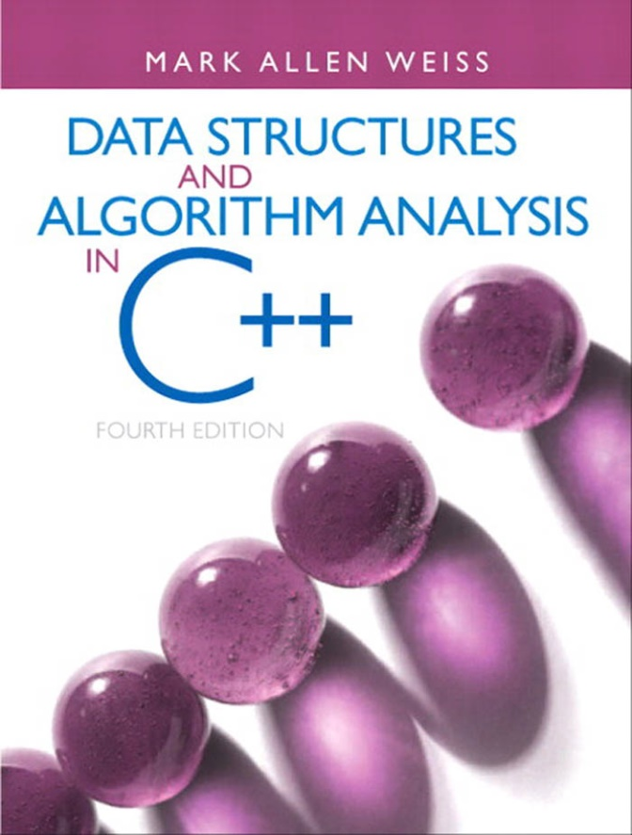
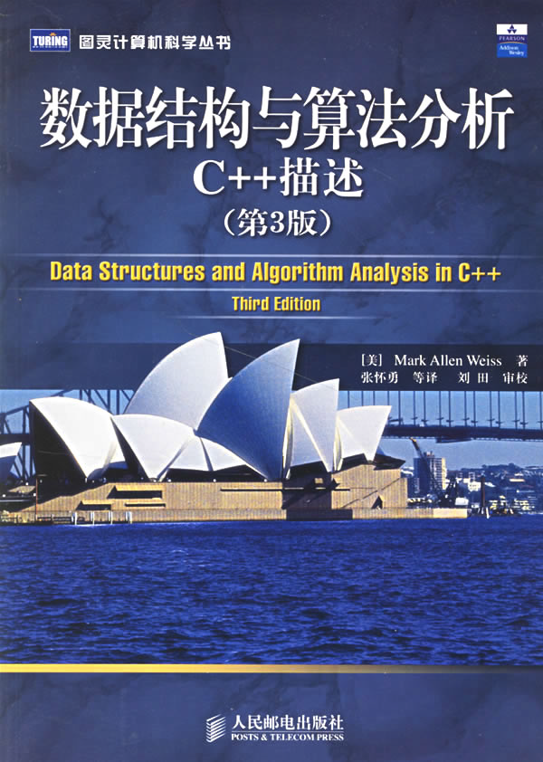
Textbook
Data Structure and Algorithm Analysis in C++, 4th edition, Mark Allen Weiss

Slide 7
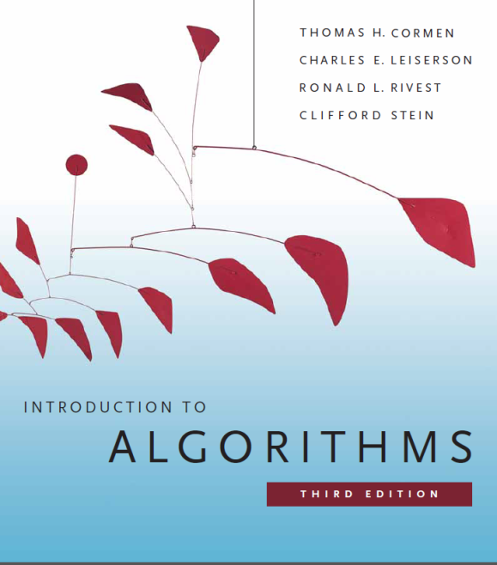
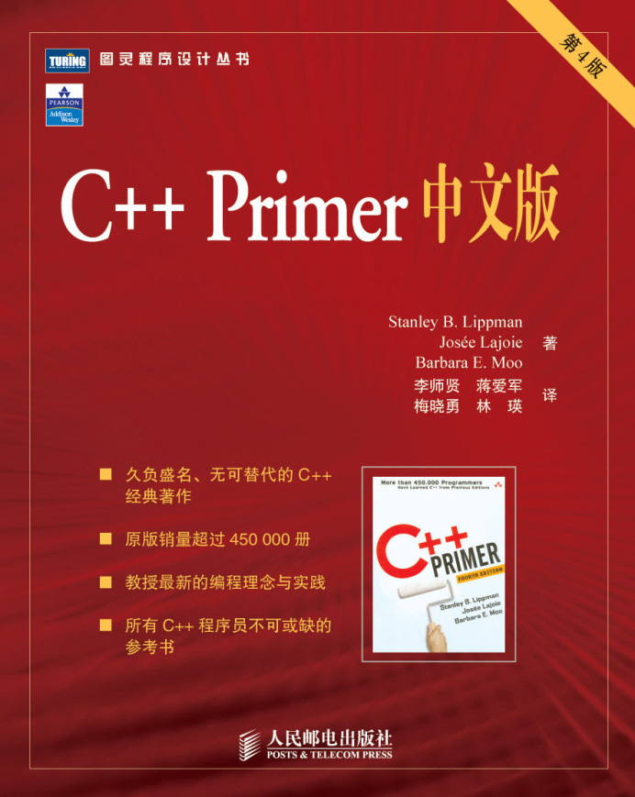
Introduction to Algorithms, 3rd edition, Thomas H. Cormen
Data Structures and Algorithm Analysis
(C++ Version), Clifford A. Shaffer
C++ Primer

Slide 8
Score
课堂成绩 15%
作业 15%
Final Project 20%
Final Examination 50%

Slide 9
Main Contents
Linear Structure
Tree
Graph
Sorting and searching
Algorithm design technology
Data Structure
Algorithm
Notes:
本门课程主要介绍的内容有如下几个方面。在数据结构部分，我们重点讲述线性结构，树型结构，图型结构，以及在这些结构上的算法。在算法部分，我们主要讲述排序算法，以及算法设计技术。需要注意的是，虽然我们这样划分了数据结构部分与算法部分，但是实际上在讲述过程中，对应于每种数据结构的一些特定的算法也会随之讲解，比如树的遍历与查找算法，比如图的遍历算法，最短路径算法等。
建立数据结构的目的是让算法更好的运行，而算法是建立在数据结构的基础上的。

Slide 10
Language
Although the material in this course is largely language-independent, programming requires the use of a specific language. As the title implies, we have chosen C++ for this course.
Generic Programming：class, template, STL
Notes:
还有一点需要强调的是，虽然课程的大部分内容是不依赖于具体的编程语言实现的，我们更多的是采用伪代码的形式来描述一个算法。但是数据结构也好，算法也好，终究是要在计算机上编程实现的，这时就需要使用一种特定的编程语言。这里我们采用C++来实现。我们可以使用c++的泛型编程来使用一段代码完成对多种数据类型的操作，而不需要为每种数据类型来多次编程。同时我们还可以使用C++中的标准模板库STL来简化我们的编程。当然，你也可以使用c来编写程序。

Slide 11
How to solve a problem with computer
Mathematic Model
Model
Object
Relationship
Algorithm
Programming
Testing & Debugging
Data Structure
Running
Notes:
使用计算机解决一个具体问题时，大致需要经过下列几个步骤：首先要从具体问题中抽象出一个适当的数学模型，然后设计一个作用于这个数学模型的算法（Algorithm），最后编出程序、进行测试、调整直至得到最终解答。
寻求数学模型的实质是分析问题，从中提取操作的对象，并找出这些操作对象之间含有的关系，然后用数学的语言加以描述。当人们用计算机处理数值计算问题是，所用的数学模型是用数学方程描述。所涉及的运算对象一般是简单的整形、实型和逻辑型数据，因此程序设计者的主要精力集中于程序设计技巧上，而不是数据的存储和组织上。然而，计算机应用的更多领域是“非数值型计算问题”，它们的数学模型无法用数学方程描述，而是用数据结构描述，解决此类问题的关键是设计出合适的数据结构，描述非数值型问题的数学模型是用线性表、树、图等结构来描述的。

Slide 12
What is program
Program
=
Data Structure
Algorithm
+
Notes:
通过前面的例子，我们可以看出，程序，其实就是 数据结构 + 算法。我们要解决一个问题，需要解决的两个问题就是找出数据对象，以及数据对象之间的结构关系，之后在该结构关系的基础上实施一定的算法，最终解决问题。这两点是程序设计的核心部分。
讲到这里，想提醒一下同学们。同学们在以后的编程过程中，不要一上来就开始敲代码，int main{ int a，double b. cin>>a, cout<<b}之类的。要先在头脑里，或者在纸上将上面说的两个部分理清。数据，数据之间的关系一一找出来，算法的过程，一一的列出来。流程图也好，伪代码也好。以一种易读易懂的逻辑形式展示出来。之后再此基础上，分析需要用到哪些变量，哪些函数，有哪些依赖关系，然后在开始coding。

Slide 13
Data Structure
In computer science, a data structure is a particular way of organizing data in a computer so that it can be used efficiently.
Data Structure = (D, S)
Notes:
数据结构是指相互之间存在着一种或多种关系的数据元素的集合和该集合中数据元素之间的关系组成。
数据结构是一门研究非数值计算的程序设计问题中计算机的操作对象（数据元素）以及它们之间的关系和运算等的学科，而且确保经过这些运算后所得到的新结构仍然是原来的结构类型。

Slide 14
Data
Char ‘a’ ‘9’
Short 1280
Int -62000
Float 3.1415926
Double 2.675e-15
Struct
Struct Student
{
int Num;
char Name[32];
float Score;
}
Struct Node
{
int Num;
float X;
float Y;
}

Slide 15
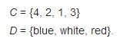
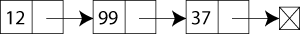
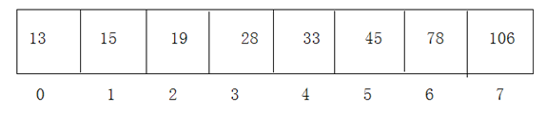
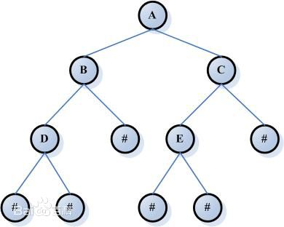
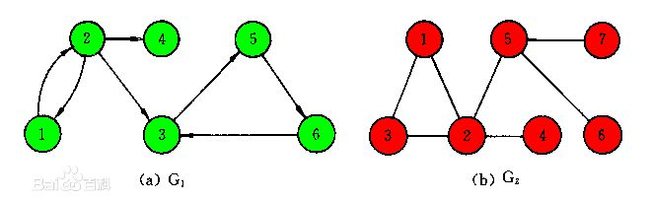
Structure
Set
Linear Structure
Tree
Graph
Notes:
集合是指具有某种特定性质的具体的或抽象的对象汇总成的集体，这些对象称为该集合的元素。集合中的元素是无序的。
线性结构是一个有序数据元素的集合。数据结构中线性结构指的是数据元素之间存在着“一对一”的线性关系的数据结构。常用的线性结构有：线性表，栈，队列，数组，串等。
树和图是非线性结构。相对应于线性结构，非线性结构的逻辑特征是一个结点元素可能对应多个直接前驱和多个后继。
树：决策问题。比如人机对弈。
图：地图，路径规划等。

Slide 16
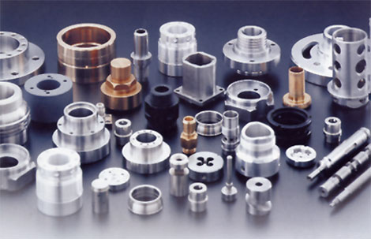
Some examples in mechanical
A set of mechanical parts

Slide 17
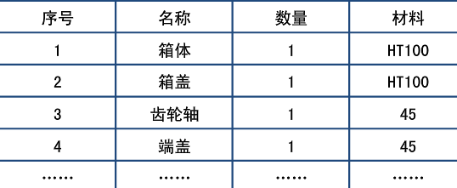
Some examples in mechanical
If we list all these parts one by one in an excel file, we can have a list (linear structure) of these parts.
减速箱明细表

Slide 18
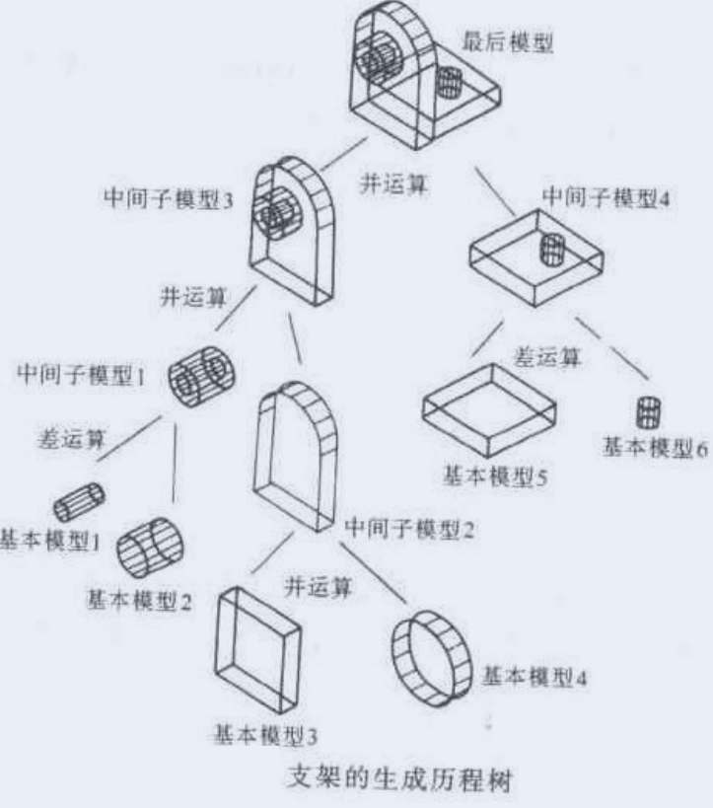
Some examples in mechanical
An assemble tree

Slide 19
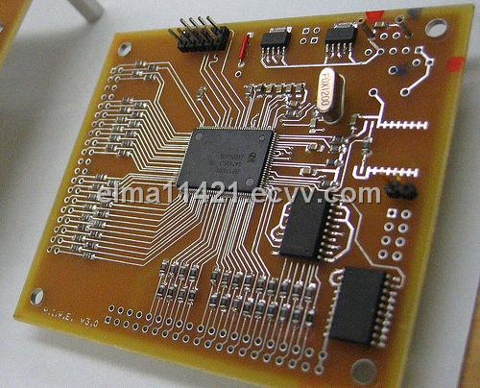
Some examples in mechanical
A PCB graph

Slide 20
Structure
Set
Linear Structure
Tree
Graph
Notes:
集合是指具有某种特定性质的具体的或抽象的对象汇总成的集体，这些对象称为该集合的元素。集合中的元素是无序的。
线性结构是一个有序数据元素的集合。数据结构中线性结构指的是数据元素之间存在着“一对一”的线性关系的数据结构。常用的线性结构有：线性表，栈，队列，数组，串等。
树和图是非线性结构。相对应于线性结构，非线性结构的逻辑特征是一个结点元素可能对应多个直接前驱和多个后继。
树：决策问题。比如人机对弈。
图：地图，路径规划等。

Slide 21
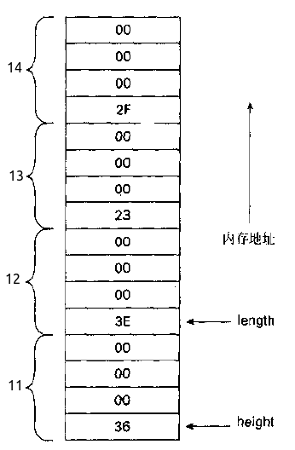
Logical Structure & Physical Structure
Logical Structure
Logical relationship between data
Set, Linear, Tree, Graph
Physical Structure
How to store the data physically
Sequential structure, Chain structure
Notes:
逻辑结构
物理结构

Slide 22
Example
8
5
12
3
7
9
15
Sequential structure
8
5
12
3
7
9
15
Chain structure
8
LC
RC
5
LC
RC
12
LC
RC
7
LC
RC

Slide 23
Abstract Data Type
An abstract data type (ADT) is a set of objects together with a set of operations.
ADT= (D, S, P)
Data
The relationship between each data
How to operate the data
Notes:
抽象数据类型(Abstract Data Type 简称ADT)是指一个数学模型以及定义在此数学模型上的一组操作。抽象数据类型的描述包括给出抽象数据类型的名称、数据的集合、数据之间的关系和操作的集合等方面的描述。抽象数据类型的设计者根据这些描述给出操作的具体实现，抽象数据类型的使用者依据这些描述使用抽象数据类型。

Slide 24
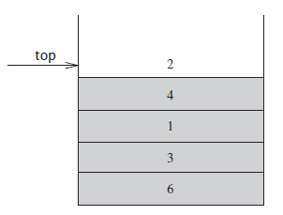
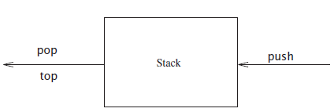
Example
Stack
push
pop
top
Notes:
A stack is a list with the restriction that insertions and deletions can be performed in only
one position, namely, the end of the list, called the top.

Slide 25
Algorithm
Informally, an algorithm is any well-defined computational procedure that takes some value, or set of values, as input and produces some value, or set of values, as output.
An algorithm is thus a sequence of computational steps that transform the input into the output.

Slide 26
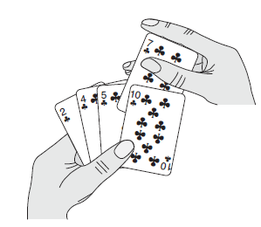
Example
Sorting problem
Input: A sequence of n numbers (a₁,a₂,…a_{n}).
Output: A reordering sequence (a’₁,a’₂,…a’_{n}) such that a’₁ ≤ a’₂, ≤ …≤a’_{n}
Insertion Sort
Notes:
Input output computational steps

Slide 27
Properties
Finiteness
Definiteness
Input
Output
Effectiveness
High efficiency
Robustness
Notes:
算法应该是有7个特性的，如下
1 有穷性（Finiteness） 算法的有穷性是指算法必须能在执行有限个步骤之后终止
2、确切性(Definiteness) 算法的每一步骤必须有确切的定义；
3、输入项(Input) 一个算法有0个或多个输入，以刻画运算对象的初始情况，所谓0个输入是指算法本身定出了初始条件；
4、输出项(Output) 一个算法有一个或多个输出，以反映对输入数据加工后的结果。没有输出的算法是毫无意义的；
5、可行性(Effectiveness) 算法中执行的任何计算步都是可以被分解为基本的可执行的操作步，即每个计算步都可以在有限时间内完成；（也称之为有效性）
6、 高效性（High efficiency） 执行速度快，占用资源少；
7、 健壮性（Robustness） 对数据响应正确。

Slide 28
Evaluate an algorithm
Running time
T(n)=O(f(n))
Space requirement
Notes:
时间复杂度：算法执行时间随规模增大而增长的趋势。以算法中重复执行的次数作为算法时间复杂度的依据。
空间复杂度：算法执行过程中所需的最大空间。输入数据所占空间+程序所占空间+辅助变量所占空间。

Slide 29
T(n)=O(f(n))
f(n)=3n²+2n+1
T(n)=O(3n²+2n+1)=O(n²)
Notes:
计算机科学中，算法的时间复杂度是一个函数，它定量描述了该算法的运行时间。这是一个关于代表算法输入值的字符串的长度的函数。时间复杂度常用大O符号表述，不包括这个函数的低阶项和首项系数。使用这种方式时，时间复杂度可被称为是渐近的，它考察当输入值大小趋近无穷时的情况。
基本操作重复执行的次数是问题规模n的某个函数f(n)，于是算法的时间量度可以记为：T(n) = O(f(n))
Ο(1)表示基本语句的执行次数是一个常数，一般来说，只要算法中不存在循环语句，其时间复杂度就是Ο(1)。

Slide 30
O(1) O(n) O(n²)
A=a+1; O(1)
for (i=0;i<n;i++){A=a+1;} O(n)
for (i=1;i<n;i++)
for (j=0;j<i;j++)
A=a+1; O(n²)
O(1)<O(log₂n)<O(n)<O(nlog₂n)<O(n²)<O(n³)<O(2^{n})

Slide 31
Design of Algorithms
Greedy Algorithm
Divide and Conquer
Dynamic Programming
Randomized Algorithm
Backtracking Algorithm
Notes:
贪心法：最短路径
分治法：快排
动态规划：
随机法：
回溯法：八皇后问题，迷宫问题

Slide 32
Main Contents
Overview of C++
Algorithm Analysis
Linear Structure
Tree
Graph Algorithm
Hashing
Sorting
Algorithm Design Technology

Slide 33
Overview of C++
Mainly review the C++ programming language.
To support the learning of this class, required programming knowledge will be recalled for this course.

Slide 34
Algorithm Analysis
How to analyse and evaluate an algorithm.
The concept of running time will also be given.

Slide 35
Linear Structure
Show a basic data structure --- the linear structure.
Three types, the list, the stack, and the queue will be introduced.
The operations that work on these linear structures will also be shown.

Slide 36
Tree
Introduce the tree structure.
The operations and algorithms, such as construction and traversals, will also be introduced.
Binary search tree and its operation will also be introduced.

Slide 37
Graph Algorithm
The graph structure.
The operations and algorithms, such as construction, traversals, shortest-path algorithms, minimum spanning tree, will also be mentioned.
Some discussion of NP-Completeness will also be carried out.

Slide 38
Hashing
Concept and operations of hashing table.

Slide 39
Sorting
Show the common sorting algorithms, which include insertion sort, bubble sort, selection sort, merge sort, quick sort, heap sort and radix sort.
Running time of these algorithms will be evaluated and compared

Slide 40
Algorithm Design Technology
Introduce some algorithm design techniques, such as greedy algorithms, divide and conquer, dynamic programming and backtracking algorithms.

Slide 41
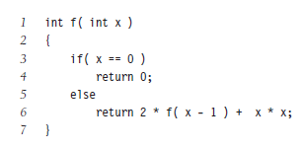
Recursion
f(x)=kx+b
f(n)=f(n-1)+n*n
f(0)=0

Slide 42
Rules
Base cases
f(0)=0
Making progress
f(n)=f(n-1)+n*n

Slide 43
Design rule. Assume that all the recursive calls work.
Compound interest rule. Never duplicate work by solving the same instance of a problem in separate recursive calls.

Slide 44
Fibonacci sequence
F（0）=0，F（1）=1，F（n）=F(n-1)+F(n-2)（n≥2，n∈N*）

Slide 45
Homework
Please give an example of the data structure and algorithm that used in your project.

Slide 46
Lecture 2 Overview of C++

Slide 47
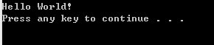
Hello World
C
C++
#include <stdio.h> int main() { printf(“Hello World!\r\n”); return 0; } | #include <iostream> using namespace std; int main() { cout<<“Hello World”<<endl; return 0; }
#include <iostream>
int main()
{
std::cout<<“Hello World”<<std::endl;
return 0;
}
namespace 命名空间
:: scope operator 作用域操作符

Slide 48
stdio vs iostream
printf int a=10; double b=5.5; char c=‘a’; printf(“a=%d, b=%f, c=%c\r\n”,a,b,c); | cout int a=10; double b=5.5; char c=‘a’; cout<<“a=“<<a<<“, b=“<<b<<“, =“<<c<<endl;
scanf int a; float b; char c; scanf(“%d %f %c”,&a,&b,&c); | cin int a; double b; char c; cin>>a>>b>>c;

Slide 49
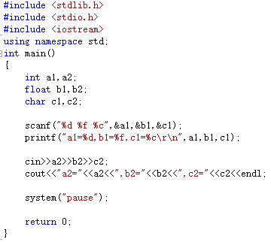
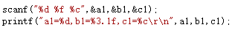
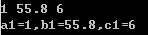
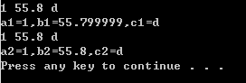

Slide 50
Comments （注释）
There are two kinds of comments in C++: single-line and paired.
Single-line comment (单行注释)
A single-line comment starts with a double slash (//) and ends with a newline.
Everything to the right of the slashes on the current line is ignored by the compiler. A comment of this kind can contain any text, including additional double slashes.
Paired comment （成对注释）
Paired comment uses two delimiters (/* and */) that are inherited from C. Such comments begin with a /* and end with the next */.
These comments can include anything that is not a */, including newlines.
The compiler treats everything that falls between the /* and */ as part of the comment.

Slide 51
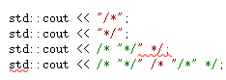
Exercise
Indicate which, if any, of the following output statements are legal:
std::cout << "/*";
std::cout << "*/";
std::cout << /* "*/" */;
std::cout << /* "*/" /* "/*" */;

Slide 52
Why is comments important
For yourself and for others
In computer programming, a comment is a programmer-readable annotation in the source code of a computer program. They are added with the purpose of making the source code easier to understand
Code Tells You How, Comments Tell You Why

Slide 53
Naming convention （命名规则）
In computer programming, a naming convention is a set of rules for choosing the character sequence to be used for identifiers which denote variables, types, functions, and other entities in source code and documentation.
Reduce the effort needed to read and understand source code;
To enable code reviews to focus on more important issues than arguing over syntax(语法) and naming
To enhance source code appearance (for example, by disallowing overlong names or unclear abbreviations).

Slide 54
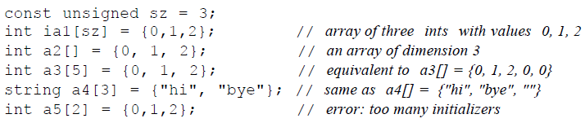
Array (数组)
In computer science, an array data structure, or simply an array, is a data structure consisting of a collection of elements (values or variables), each identified by at least one array index or key.
a[0]
a[4]
a[8]
int a[10];
1 | 2 | 3 | 4 | 5 | 6 | 7 | 8 | 9 | 10

Slide 55
Attention
int a[]; //error
int a[5]; //it’s OK.
a={1,2,3,4,5} //error
a[3]=4; //right
int b[5]=a; //error
b=a; //error
b[2]=a[1]; //right

Slide 56
Pointer (指针)
In computer science, a pointer is a programming language object, whose value refers to (or "points to") another value stored elsewhere in the computer memory using its address.
int a=10;
int *b=&a;
int *c;
c=&a;
int *d;
d=c;
Var(变量) | Address(地址) | Contents（内容）
a | 0x0114FC48 | 10
b | 0x0114FC3C | 0x0114FC48
c | 0x0114FC30 | 0x0114FC48
d | 0x0114FC24 | 0x0114FC48

Slide 57
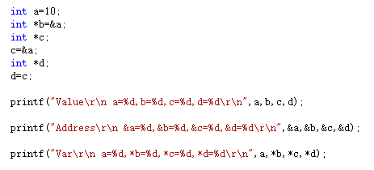
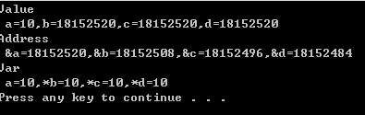

Slide 58
Array and Pointer
int a[10]={1,2,3};
int *b=a;
a[2],b[2]
*(a+2),*(b+2)
for (int i=0;i<10;i++)
{ a[i]=i; b[i]=i; *(a+i)=i; *(b+i)=i;}
These four have the same result.

Slide 59
Array and Pointer
int a[10]={1,2,3};
int *b=a;
b++; b[0]=?
b=b+3; b[0]=?
a++; a[0]=?
a=a+3; a[0]=?

Slide 60
Array and Pointer
It is an array, each element is a pointer
int *a1[3]
int (*a2)[3]
int *b; a1[0]=b;
int c[10][3]; a2=c; a2[5][2]=4;
int c2[3];
a2=c2 ?
a2=&c2;
It is a pointer. It points to an array
with 3 elements
error

Slide 61
Flow of Control (控制流)
while
do while
for
if
switch case
goto

Slide 62
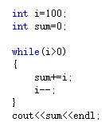
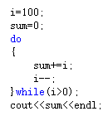
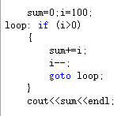
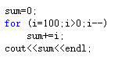
Example
Calculate 1+2+3+…+100
What’s the difference between while and do while
？

Slide 63
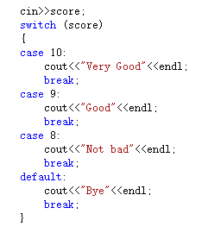
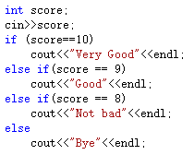
Example 2
If and switch

Slide 64
Function （函数）
In computer programming, a subroutine(子程序) is a sequence of program instructions that perform a specific task, packaged as a unit.
A function definition typically consists of a return type, a name, a list of zero or more parameters, and a body.
int add(int a, int b)
{
return a+b;
}

Slide 65
Argument Passing (参数传递)
Passed by value
(按值传递)
Passed by reference
(引用传递)

Slide 66
Example
void swap(int a, int b)
{ int c; c=a; a=b; b=c; }
int a1, a2;
a1=10;a2=5;
swap(a1,a2); //Passed by value

Slide 67
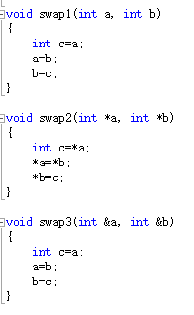
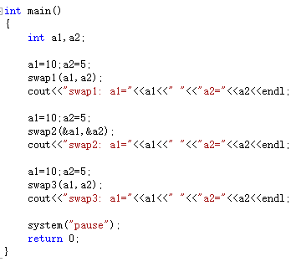
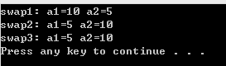
C
C++
Passed by value
Passed by reference

Slide 68
Reference and Pointer
Reference | Pointer
int a=10; int &r=a; r=5; | int a=10; int *r=&a; *r=5;
A reference must be initialized when it is created. (Pointers can be initialized at any time.)
Once a reference is initialized to an object, it cannot be changed to refer to another object. (Pointers can be pointed to another object at any time.)
You cannot have NULL references. You must always be able to assume that a reference is connected to a legitimate piece of storage.

Slide 69
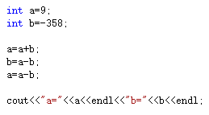
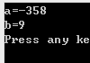
Brain Storming (头脑风暴)
int a,b,c;
c=a;
a=b;
b=c;
Can you change the values of a and b without a third value c?

Slide 70
Function pointer and pointer function
int *f(int x, int y){} //pointer function
f is a function, it returns a pointer
int (*f)(int x, int y){} //function pointer
f is a pointer, it points to a function

Slide 71
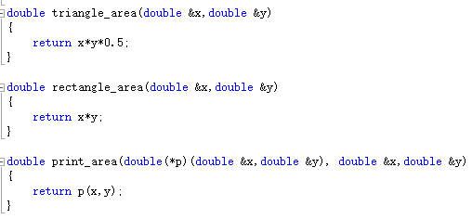
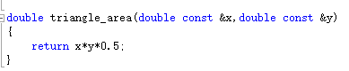
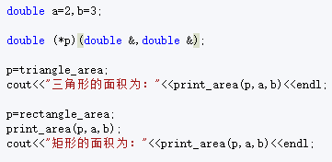
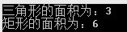
Example

Slide 72
Define and Const
C | C++
#define MAX 1024 | const int MAX=1024
#define max(a,b) ( (a)>(b) ? (a) : (b)) | inline int max(int a, int b) { return a>b ? a : b; }

Slide 73
Class（类）
Class Members(类成员)
Constructors(构造函数)
Member Functions(成员函数)

Slide 74
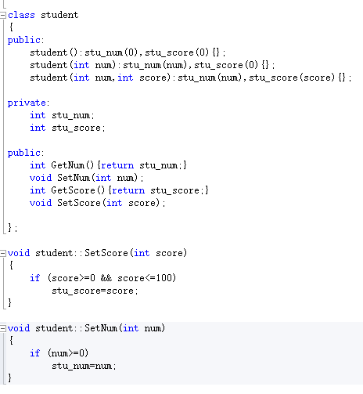
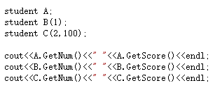
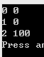
constructor initializer list
构造函数初始化列表

Slide 75
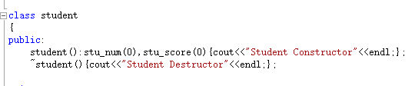
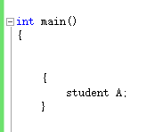
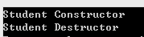
Constructor and Destructor （构造函数与析构函数）

Slide 76
Class （类）
Most fundamentally, a class defines a new type and a new scope.
The fundamental ideas behind classes are data abstraction（抽象） and encapsulation（封装）

Slide 77
Abstraction（抽象）
Data abstraction is a programming (and design) technique that relies on the separation of interface and implementation. The class designer must worry about how a class is implemented, but programmers that use the class need not know about these details. Instead, programmers who use a type need to know only the type's interface; they can think abstractly about what the type does rather than concretely about how the type works.

Slide 79
Encapsulation（封装）
Encapsulation is a term that describes the technique of combining lower-level elements to form a new, higher-level entity. A function is one form of encapsulation: The detailed actions performed by the function are encapsulated in the larger entity that is the function itself.
Encapsulated elements hide the details of their implementation. We may call a function but have no access to the statements that it executes. In the same way, a class is an encapsulated entity: It represents an aggregation of several members, and most (well-designed) class types hide the members that implement the type.

Slide 80
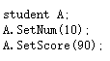
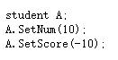

Slide 81



Encapsulation(封装)
By using the private word, you can hide the member variable. Users can only access these values through member functions.

Slide 82
Inheritance (继承)
In object-oriented programming, inheritance is when an object or class is based on another object or class, using the same implementation (inheriting from an object or class) specifying implementation to maintain the same behaviour (realizing an interface; inheriting behaviour).
It is a mechanism for code reuse and to allow independent extensions of the original software via public classes and interfaces.

Slide 83


Inheritance (继承)

Slide 84





Slide 85
Structure and Class (结构体与类)
 | Structure (C) | Class (C++)
Example | Struct stu { int num; char name[20]; int age; int (*getScore)(); } | Class stu { stu(); private: int num; char name[20]; int age public： int GetScore(); }
Member Function (成员函数) | N | Y
Access (权限) | public | Private, public
Inheritance (继承) | N | Y
Design (设计) | Separate operations from data | Data+operations

Slide 86
Template(模板)
Templates are a feature of the C++ programming language that allows functions and classes to operate with generic types.
This allows a function or class to work on many different data types without being rewritten for each one.

Slide 87
Template(模板)
Function: compare
int compare( int a, int b);
int compare (double a, double b);
int compare (char a, char b);
{
return a>b ? 1 : 0;
}

Slide 88
Template(模板)
Function: compare
int compare( int a, int b);
int compare (double a, double b);
int compare (char a, char b);
{
return a>b ? 1 : 0;
}

Slide 89



Overload
重载
C++

Slide 90
Function Template(函数模板)
Function: compare
template <typename T>
int compare( T a, T b);
{
return a>b ? 1 : 0;
}

Slide 91


Slide 92

Class Template(类模板)

Slide 93



Slide 94
STL
The Standard Template Library (STL) is a software library for the C++ programming language that influenced many parts of the C++ Standard Library. It provides four components called algorithms, containers, functional, and iterators.

Slide 95
Vector
Vectors are sequence containers representing arrays that can change in size.
Sequence
Elements in sequence containers are ordered in a strict linear sequence. Individual elements are accessed by their position in this sequence.
Dynamic array
Allows direct access to any element in the sequence, even through pointer arithmetics, and provides relatively fast addition/removal of elements at the end of the sequence.
Allocator-aware
The container uses an allocator object to dynamically handle its storage needs.

Slide 96


http://www.cplusplus.com/reference/vector/vector/

Slide 97




Slide 98
Homework
Write a function template swap3, for 3 input numbers, a1,a2,a3, after this function, a1>=a2>=a3.
Write a class template to realize a “stack” structure.

Slide 101

An example of programming
How it works?
What do I have?

Slide 102
Message Based, Event Driven
MSG msg;
while(GetMessage(&msg,NULL,NULL,NULL))
{
TranslateMessage(&msg);
DispatchMessage(&msg);
}

Slide 103
Initialize the map
Receive and dispatch MSG
Handle MSG

Slide 104
Left
Function
ButtonDown
Right
ButtonUp
Both
Timer
Function
Paint
Function
Map Data

Slide 105
Lecture 3 Algorithm Analysis

Slide 106
Algorithm
An algorithm is a clearly specified set of simple instructions to be followed to solve a problem.
Once an algorithm is given for a problem and decided (somehow) to be correct, an important step is to determine how much in the way of resources, such as time or space, the algorithm will require.
Notes:
算法是为求解一个问题而建立的一个简单指令的集合。遵循这个指定的集合，我们可以完成特定任务，功能。

Slide 107
Properties
Finiteness (有穷性)
Definiteness (确定性)
Input (输入)
Output (输出)
Effectiveness (可行性)
High efficiency (高效)
Robustness (鲁棒性)
Notes:
算法应该是有7个特性的，如下
1 有穷性（Finiteness） 算法的有穷性是指算法必须能在执行有限个步骤之后终止
2、确切性(Definiteness) 算法的每一步骤必须有确切的定义；
3、输入项(Input) 一个算法有0个或多个输入，以刻画运算对象的初始情况，所谓0个输入是指算法本身定出了初始条件；
4、输出项(Output) 一个算法有一个或多个输出，以反映对输入数据加工后的结果。没有输出的算法是毫无意义的；
5、可行性(Effectiveness) 算法中执行的任何计算步都是可以被分解为基本的可执行的操作步，即每个计算步都可以在有限时间内完成；（也称之为有效性）
6、 高效性（High efficiency） 执行速度快，占用资源少；
7、 健壮性（Robustness） 对数据响应正确。

Slide 108
Contents of this lecture
How to estimate the time required for a program.
How to reduce the running time of a program.

Slide 109

Mathematical Background
Definition 1
T(N)=O(f(N)), if there are positive constants c and n₀, such that T(N)<=cf(N) when N>=n₀.
T(N)=1000N, f(N)=N^2;
c=1, n₀=1000, T(N)<=cf(N) when N>=n₀.
f(N)=N^2
T(N)=1000N
Notes:
估计算法资源消耗所需的分析一般来说是一个理论问题，因此需要一套正式的系统构架。这里，我们将先从某些数学定义说起

Slide 110
Mathematical Background
Definition 2
T(N)=Ω(f(N)), if there are positive constants c and n₀, such that T(N)>=cf(N) when N>=n₀.
T(N)=N², f(N)=1000N;
c=1, n₀=1000, T(N)>=cf(N) when N>=n₀.

Slide 111
Mathematical Background
Definition 3
T(N)=Θ(f(N)), if and only if T(N)=O(f(N)) and T(N)=Ω(f(N)).
T(N)=2N², f(N)=N²+2N;
c=1, n₀=2, T(N)>=cf(N) when N>=n₀.
c=2, n₀=1, T(N)<=cf(N) when N>=n₀.

Slide 112
Mathematical Background
Definition 4
T(N)=o(f(N)), if for all positive constants c, there exists an n₀ such that T(N)<cf(N) when N>n0.
T(N)=o(f(N)), if T(N)=O(f(N)), and T(N)≠Θ(f(N)

Slide 113
Mathematical Background
Relative rates of growth (相对增长率)
When we say that T(N) = O(f (N)), we are guaranteeing that the function T(N) grows at a rate no faster than f (N); thus f (N) is an upper bound on T(N); T(N) is a lower bound on f (N).
T(N) = O(f (N)) => f(N) = Ω(T (N))

Slide 114
Using Big-Oh notation
Tt is very bad style to include constants or low-order terms inside a Big-Oh. Do not say T(N) = O(2N²) or T(N) = O(N²+N). In both cases, the correct form is T(N) = O(N²).
This means that in any analysis that will require a Big-Oh answer, all sorts of shortcuts are possible. Lower-order terms can generally be ignored, and constants can be thrown away. Considerably less precision is required in these cases.

Slide 115



Some rules

Slide 116
Typical Growth Rates
function | Name
c | constant
logN | logarithmic
log²N | Log-squared
N | Linear
NlogN
N² | quadratic
N³ | cubic
2^{N} | exponential

Slide 117
We can always determine the relative growth rates of two functions f (N) and g(N) by computing lim_{N→∞} f (N)/g(N).
The limit can have four possible values:

Slide 118
Find two functions f (N) and g(N) such that neither f (N) = O(g(N)) nor g(N) =O(f (N)).

Slide 119
NlogN vs N^{1.5}
f(N)=NlogN
g(N)=N^{1.5}
NlogN is better
NlogN vs N^{1.5}
logN vs N^{0.5}
log²N is better
log²N vs N

Slide 120
General Rules
1: for loops (for 循环)
The running time of a for loop is at most the running time of the statements inside the for loop (including tests) times the number of iterations.
2: nested loops (嵌套循环)
Analyze these inside out. The total running time of a statement inside a group of nested loops is the running time of the statement multiplied by the product of the sizes of all the loops.

Slide 121
General Rules
3: consecutive statements (顺序语句)
These just add.
4: if/else
the running time of an if/else statement is never more than the running time of the test plus the larger of the running times of S1 and S2.

Slide 122
Example 1
1+2+3+…+N
sum=0;
for (i=1;i<=N;i++)
sum+=i;
O(N)

Slide 123
Example 2
sum=0;
for (i=1; i<=N; i++)
for (j=0; j<i; j++)
sum+=i*j;
O(N²)

Slide 124
Example 3
sum=0;
for (i=1;i<=N;i++)
sum+=i;
for (i=1;i<=N;i++)
for (j=0;j<i;j++)
sum+=i*j;
O(N²)+O(N)=O(N²)

Slide 125

Example 4
x^{n}
O(logN)

Slide 126




Fibonacci Sequence (斐波那契数列)
F(0)=0;F(1)=1;F(n)=F(n-1)+F(n-2);

Slide 127

Fibonacci Sequence (斐波那契数列)
F(0)=0;F(1)=1;F(n)=F(n-1)+F(n-2);
T(N) = T(N − 1) + T(N − 2) + 2
O(N)

Slide 128
Fibonacci Sequence (斐波那契数列)
Can we future improve our algorithm?
O(logN)

Slide 129

Maximum Subsequence Sum (最大子序列和问题)
Maximum Subsequence Sum Problem
Given (possibly negative) integers A1, A2, . . . , AN, find the maximum value of $\sum_{k=i}^{j}{Ak}$
(For convenience, the maximum subsequence sum is 0 if all the integers are negative.)
Example:
For input −2, 11, −4, 13, −5, −2, the answer is 20 (A2 through A4).

Slide 130


O(N³)
O(N²)

Slide 131


O(NlogN)
O(N)

Slide 132




Slide 133
Exercise
An algorithm takes 0.5 ms for input size 100. How long will it take for input size 500 if the running time is the following (assume low-order terms are negligible)?
a. linear
b. O(N logN)
c. quadratic
d. cubic

Slide 134
Lecture 4 Linear Structure I

Slide 135
ADT(抽象数据类型)
An abstract data type (ADT) is a set of objects together with a set of operations
ADT= (D, S, P)
Data
The relationship between each data
How to operate the data

Slide 136
Notes
There is no rule telling us which operations must be supported for each ADT; this is a design decision.
Error handling(错误处理) and tie breaking(结构调整) (where appropriate) are also generally up to the program designer
The implementation can be done in several ways, but if they are done correctly, the programs that use them will not necessarily need to know which implementation was used.

Slide 137
The List ADT
ADT= (D, S, P)
Data:
A₀,A₁,A₂,…A_{n}, data with the same type.
n is the list size. n=0 is called an empty list
Structure
Ai follows (or succeeds) (后继)A_{i-1} (i < N) and that A_{i−1} precedes(前驱) Ai (i > 0).
Operation
printList, makeEmpty, insert, remove, find

Slide 138


Implementation
Array
Linked list
Doubly linked list
A0 | A1 | A2 | A3 | A4 | A5 | A6

Slide 139
Array based List
An array implementation allows printList to be carried out in linear time, and the findKth operation takes constant time, which is as good as can be expected.
However, insertion and deletion are potentially expensive, depending on where the insertions and deletions occur.

Slide 140
Array based List
7
1 | 2 | 3 | 4 | 5 | 6
1 | 7 | 2 | 3 | 4 | 5 | 6
2
1 | 7 | 3 | 4 | 5 | 6

Slide 141




Array based List

Slide 142



Array based List

Slide 143


Array based List
1 | 7 | 2 | 3 | 4 | 5 | 6
1 | 7 | 3 | 4 | 5 | 6

Slide 144

Linked List
In order to avoid the linear cost of insertion and deletion, we need to ensure that the list is not stored contiguously, since otherwise entire parts of the list will need to be moved.
The linked list consists of a series of nodes, which are not necessarily adjacent in memory. Each node contains the element and a link to a node containing its successor. We call this the next link. The last cell’s next link points to nullptr.

Slide 145



Linked List
7
1
2
3
4
5 | NULL
1
2
3
4
5 | NULL
7

Slide 146



Linked List
1
2
7
3
4
5 | NULL
P0
P1
Delete(3)

Slide 147
Linked List
1
2
7
3
4
5 | NULL
pre
cur
next
Reverse
cur->next=pre
pre=cur
cur=next
next=next->next
5
4
3
7
2
1 | NULL

Slide 148
Doubly Linked List
1
n
2
3
4
5
6
7
n
8

Slide 149





Doubly Linked List
4
5
p1
Insert(7)

Slide 150
Doubly Linked List
3
4
5
p->next->pre=p->pre
p
delete(4)
p->pre->next=p->next
delete p;
p=NULL;

Slide 151

Notes for using pointer
int* a,b;
int d=10;
a=&d;
b=&d;

Slide 152

Notes for using pointer
typedef int* int_p;
int* a,b;
int d=10;
a=&d;
b=&d;

Slide 153

Notes for using pointer
int* a=NULL;
a=new int[10];
a[0]=1;
int *b=NULL;
void f(int *c)
{
c=new int[10];
}
f(b);
b[0]=1;

Slide 154



Notes for using pointer

Slide 155



Notes for using pointer

Slide 156
Memory Distribution
Stack(栈区)
Heap(堆区)
Static(全局区/静态区)
文字常量区
程序代码区
Notes:
1、栈区（stack）— 由编译器自动分配释放 ，存放函数的参数值，局部变量的值等。其操作方式类似于数据结构中的栈。
2、堆区（heap） — 一般由程序员分配释放， 若程序员不释放，程序结束时可能由os回收 。注意它与数据结构中的堆是两回事，分配方式倒是类似于链表，呵呵。
3、全局区（静态区）（static）—，全局变量和静态变量的存储是放在一块的，初始化的全局变量和静态变量在一块区域， 未初始化的全局变量和未初始化的静态变量在相邻的另一块区域。 - 程序结束后有系统释放。
4、文字常量区 —常量字符串就是放在这里的。 程序结束后由系统释放。
5、程序代码区—存放函数体的二进制代码。

Slide 157
Lecture 5 Linear Structure II

Slide 158
Stack ADT
A stack is a list with the restriction that insertions and deletions can be performed in only one position, namely, the end of the list, called the top.
The fundamental operations on a stack are push, which is equivalent to an insert, and pop, which deletes the most recently inserted element.

Slide 159


LIFO (Last in, First out)

Slide 160
Note
A pop or top on an empty stack is generally considered an error in the stack ADT.
Running out of space when performing a push is an implementation limit but not an ADT error.

Slide 161
Implementation
Since a stack is a list, any list implementation will do.
Linked List Implementation of Stacks
Array Implementation of Stacks

Slide 162
Notice that these operations are performed in not only constant time but very fast constant time.
On some machines, pushes and pops (of integers) can be written in one machine instruction, operating on a register with auto-increment and auto-decrement addressing.
The fact that most modern machines have stack operations as part of the instruction set enforces the idea that the stack is probably the most fundamental data structure in computer science, after the array.

Slide 163
Queue ADT
Like stacks, queues are lists.
With a queue, however, insertion is done at one end whereas deletion is performed at the other end.

Slide 164
Queue Model
enqueue
inserts an element at the end of the list (called the rear)
Dequeue
which deletes (and returns) the element at the start of the list (known as the front)

Slide 165


FIFO (First in, First out)

Slide 166
front
int q1[10];
back
q1[back++]=1;
enqueue(1)
front
Return q1[front++];
1
back
Beware of size
enqueue(2), enqueue(3),
enqueue(4), dequeue
size=back-front
1 | 2 | 3 | 4
front
back
isEmpty:
Size==0?
Back==front?

Slide 167




a=?7
preferred
May lead to serious bug and it is hard to be found.

Slide 168
front
int q1[10];
back
q1[back++]=1;
enqueue(1)
front
Return q1[front++];
1
back
Beware of size
enqueue(2), enqueue(3),
enqueue(4), dequeue
size=back-front
1 | 2 | 3 | 4
front
back
isEmpty:
0==Size?
Back==front?

Slide 169
Circular Queue (循环队列)
1 | 2 | 3 | 4 | 5 | 6 | 7 | 8 | 9
++back;
If (back==MaxLen)
back=0;
front
back
enqueue(10)
size
1 | 2 | 3 | 4 | 5 | 6 | 7 | 8 | 9 | 10
(back+MaxLen-front)%MaxLen
back
front
enqueue(11)
isFull?
size==MaxLen-1
11 | 2 | 3 | 4 | 5 | 6 | 7 | 8 | 9 | 10
isEmpty?
size==0
back
front

Slide 170
Applications of Queues
Virtually every real-life line is (supposed to be) a queue. For instance, lines at ticket counters are queues, because service is first-come first-served.
Print queue.

Slide 171
Applications of Stack
Balancing Symbols (平衡符号)
Postfix Expressions (后缀表达式)
Infix to Postfix Conversion (中缀到后缀的转换)

Slide 172
Balancing Symbols
Check whether everything is balanced.
Every right brace, bracket, and parenthesis must correspond to its left counterpart.
Paired symbols such as begin/end, /* */, and so on.

Slide 173
Example
Check if the following expression is balance
{[()({[]})]}
{[(()(]})]}
How to check it with program ?

Slide 174
Balancing Symbols
Make an empty stack.
Read characters until end of file.
If the character is an opening symbol, push it onto the stack.
If it is a closing symbol and the stack is empty, report an error.
Otherwise, pop the stack.
If the symbol popped is not the corresponding opening symbol, then report an error.
At end of file, if the stack is not empty, report an error.

Slide 175
Example
{ [ ( ) ( { [ ] } ) ] }
{
[
{
(
[
{
(
[
{
(
[
{
{
(
[
{
[
{
(
[
{
[
{
(
[
{
{
(
[
{
(
[
{
[
{
{
{ [ ( ( ) ( ] } ) ] }
{
[
{
(
[
{
(
(
[
{
(
(
[
{
(
(
[
{
(
(
[
{

Slide 176
Infix and Postfix Expressions
5 + 7 * 3 - ( 6 * 2 + 1 ) / 10 infix
5 7 3 * + 6 2 * 1 + 10 / -
postfix

Slide 177
Application of Postfix Expressions
5 + 7 * 3 - ( 6 * 2 + 1 ) / 10 infix
5 7 3 * + 6 2 * 1 + 10 / - postfix
How to calculate the above expression with program
When a number is seen, it is pushed onto the stack
When an operator is seen, the operator is applied to the two numbers (symbols) that are popped from the stack
Push the result back to the stack.

Slide 178
Example
5 + 7 * 3 - ( 6 * 2 + 1 ) / 10
5 7 3 * + 6 2 * 1 + 10 / -
5
7
5
3
7
5
21
5
26
6
26
2
6
26
12
26
1
12
26
13
26
10
13
26
1.3
26
24.7
7*3=21
5+21=26
6*2=12
12+1=13
13/10=1.3
26-1.3=24.7

Slide 179
Infix to Postfix Conversion
Not only can a stack be used to evaluate a postfix expression, but we can also use a stack to convert an expression in standard form (infix) into postfix.
5 + 7 * 3 - ( 6 * 2 + 1 ) / 10 infix
5 7 3 * + 6 2 * 1 + 10 / - postfix

Slide 180
Infix to Postfix Conversion
When an operand is read, it is immediately placed onto the output.
Operators are not immediately output.
If the stack is empty, or if the operator at the top has lower priority, push the operator.
Else, pop entries from the stack until the top has lower priority.
And then push the operator.
If we see a right parenthesis, then we pop the stack, writing symbols until we encounter a (corresponding) left parenthesis, which is popped but not output.

Slide 181
Infix to Postfix Conversion
 | + | - | * | / | ( | )
+ | = | = | < | < | < | >
- | = | = | < | < | < | >
* | > | > | = | = | < | >
/ | > | > | = | = | < | >
( | > | > | > | > | = | >
) | < | < | < | < | < | =

Slide 182
Example
5 + 7 * 3 - ( 6 * 2 + 1 ) / 10
+
+
*
+
*
+
-
(
-
(
-
*
(
-
*
(
-
+
(
-
+
(
-
-
/
-
/
-
5
7
3
*
+
6
2
*
1
+
10
/
-

Slide 183
Priority Table
 | + | - | * | / | ( | )
+ | 0 | 0 | 0 | 0 | 1 | -1
- | 0 | 0 | 0 | 0 | 1 | -1
* | 1 | 1 | 0 | 0 | 1 | -1
/ | 1 | 1 | 0 | 0 | 1 | -1
( | 1 | 1 | 1 | 1 | 1 | -1
) | 0 | 0 | 0 | 0 | 0 | -1
Top of the stack
Reading from the input

Slide 184
Priority Table
 | + | - | * | / | ( | )
+ | 0 | 0 | 0 | 0 | 1 | -1
- | 0 | 0 | 0 | 0 | 1 | -1
* | 1 | 1 | 0 | 0 | 1 | -1
/ | 1 | 1 | 0 | 0 | 1 | -1
( | 1 | 1 | 1 | 1 | 1 | -1
) | 0 | 0 | 0 | 0 | 0 | -1
Top of the stack
Reading from the input

Slide 185
Expression Evaluation
Combine the three applications together
Balancing Symbols
Use to check if the expression is right
Postfix Expressions
Use a stack to store operands
Infix to Postfix Conversion
Use a stack to store operators
Run at the same time

Slide 186
Example
5 + 7 * 3 - ( 6 * 2 + 1 ) / 10
+
+
*
+
*
+
-
(
-
(
-
*
(
-
*
(
-
+
(
-
+
(
-
-
/
-
/
-
-
5
5
7
5
7
5
3
7
5
21
5
26
6
26
6
26
2
6
26
12
26
1
12
26
13
26
13
26
10
13
26
1.3
26
24.7

Slide 187
Note
If the stack is empty, or if the operator at the top has lower priority, push the operator.
Else, pop entries from the stack until the top has lower priority.
a+b-c+d
? Why not “equal or lower”
Lower: a b + c – d +
equal or lower:
a b c d + - +
a+b-(c+d)

Slide 188
Note
Make your own decision which design to chose

Slide 189





Homework II
Write a program to calculate an expression. For example, input an expression 10.8+20.4*(36.5-5)^2.5+8, your program should give the result 113626.182
A pdf file should be submitted, in which the running results of above two programs should be listed. The coding and running environment should also be listed.
Source code should also be submitted along with the executable file so that the program can be tested.
Compress the pdf file and the source files along with the executable file into a rar or zip file, named DS_姓名_学号. Send the file to TA no latter than Mar. 28

Slide 190
Lecture 6 Tree I

Slide 191

What is a tree

Slide 192
Definition of a Tree
One natural way to define a tree is recursively.
A tree is a collection of nodes.
The collection can be empty;
otherwise, a tree consists of a distinguished node, r, called the root(根), and zero or more nonempty (sub)trees(子树) T1, T2, . . . , Tk
each of the roots of the subtrees are connected by a directed edge(边) from r.

Slide 193

Example
I’m a tree
Root
T1
T2
T3
T11
T21
T12

Slide 194

Some Definitions
Child and parent
Leaf (叶)
Sibling(兄弟)
Grandparent and grandchild
Path and length
Depth and height
Ancestor and descendant
Proper ancestor
Proper descendant
Root
For a tree with N node, how many edges will there be?
T1
T2
T3
T11
T12
T21
Notes:
The root of each subtree is said to be a child of r, and r is the parent of each subtree root.
Each node may have an arbitrary number of children, possibly zero.
Nodes with no children are known as leaves
Nodes with the same parent are siblings
Grandparent and grandchild relations can be defined in a similar manner
A path from node n1 to nk is defined as a sequence of nodes n1, n2, . . . , nk such that ni
is the parent of ni+1 for 1 ≤ i < k. The length of this path is the number of edges on the
path, namely, k − 1. There is a path of length zero from every node to itself. Notice that in
a tree there is exactly one path from the root to each node.
For any node ni, the depth of ni is the length of the unique path from the root to ni.
Thus, the root is at depth 0. The height of ni is the length of the longest path from ni to a
leaf.
If there is a path from n1 to n2, then n1 is an ancestor of n2 and n2 is a descendant of
n1. If n1 != n2, then n1 is a proper ancestor of n2 and n2 is a proper descendant of n1.

Slide 195
Binary Tree (二叉树)
A binary tree is a tree in which no node can have more than two children.
R
T1
T2
T21

Slide 196
Questions
1, for a binarytree with N nodes, what’s its max depth, and what’s its min depth?
2, for a binarytree, how many nodes can it have on the depth i
2, for a binarytree with depth d, what’s its max nodes, and what’s its min nodes?
N
log₂N
1
2^{i}
2^{d+1}-1
d+1

Slide 197

Questions
4, for a binarytree, N₀ nodes have no child, N₂ nodes have two children. Therefore what’s the relationship between these two number?
N₀=N₂+1

Slide 198
Some Definitions
Perfect Binary Tree
All nodes have two children expect the leaves.
All leaves are on the same level.
Each level has reached its maximum nodes
Complete Binary Tree
Each level has reached its maximum nodes except the last level
All nodes on the last level are on the left side.

Slide 199




Example
Perfect Binary Tree
Complete Binary Tree
A Perfect binary tree is a complete binary tree

Slide 200
Perfect Binary Tree
American: a binary tree in which all interior nodes have two children and all leaves have the same depth or same level
In China : It is called full binary tree
Full Binary Tree
American: a tree in which every node in the tree has either 0 or 2 children
In China: a perfect binary tree

Slide 201

Example
Perfect Binary Tree in America
Full Binary Tree in China
Full Binary Tree in America
Strict Binary Tree in China
A full binary tree is a complete binary tree in China

Slide 202




Implementation of Trees
struct
pointer
a
0 | &b
b2
0 | &a
b
0 | a2
a2
0 | b2

Slide 203


Implementation of Trees
data | firstChild | nextSibling
Root |  | Null
T1
T2
T3 | null | null
T21 | null | null
T11 | null
T12 | null | null

Slide 204


Implementation of Trees
leftChild | data | rightChild
 | R
null | T1 | null
null | T2
null | T21 | null

Slide 205


Application of Trees
One of the popular uses is the directory structure in many common operating systems, including UNIX and DOS. Figure is a typical directory in the UNIX file system.

Slide 206

Traversal
Pseudocode ( 伪代码 ) to list a directory in a hierarchical file system
Notes:
伪码（Pseudocode）是一种算法描述语言。使用伪码的目的是使被描述的算法可以容易地以任何一种编程语言（Pascal，C，Java等）实现。因此，伪代码必须结构清晰、代码简单、可读性好，并且类似自然语言。 介于自然语言与编程语言之间。以编程语言的书写形式指明算法职能。使用伪代码， 不用拘泥于具体实现。相比程序语言（例如Java, C++,C, Dephi 等等）它更类似自然语言。它是半角式化、不标准的语言。可以将整个算法运行过程的结构用接近自然语言的形式（可以使用任何一种你熟悉的文字，关键是把程序的意思表达出来）描述出来。

Slide 207

Traversal

Slide 208
Traversal
What is the traversal result using the previous method?
R
 | T1
 |  | T11
 |  | T12
 | T2
 |  | T21
 | T3
preorder traversal
(前序遍历)
R | T1 | T11 | T12 | T2 | T21 | T3

Slide 209
Preorder Traversal
R | T1 | T11 | T12 | T2 | T21 | T3
Traverse root
Traverse each child

Slide 210
Postorder Traversal
Traverse each child
Traverse root

Slide 211
Postorder Traversal
 |  | T11
 |  | T12
 | T1
 |  | T21
 | T2
 | T3
R
T11 | T12 | T1 | T21 | T2 | T3 | R

Slide 212



Traversal

Slide 213

Traversal

Slide 214
Level-order Traversal
Traverse depth i
Traverse depth i+1

Slide 215
Preorder Traversal for BinaryTree
R | T1 | T11 | T12 | T123 | T2 | T21
Traverse root
Traverse the left child
Traverse the right child

Slide 216
Postorder Traversal for BinaryTree
T11 | T123 | T12 | T1 | T21 | T2 | R
Traverse the left child
Traverse the right child
Traverse root

Slide 217
Inorder Traversal for BinaryTree
T11 | T1 | T12 | T123 | R | T2 | T21
Traverse root
Traverse the right child
Traverse the left child

Slide 218





Traversal for BinaryTree

Slide 219

Traversal for BinaryTree

Slide 220
How the traversal runs
P(T11)
P(N)
P(T1)
P(T11)
P(T12)
P(N)
P(T1)
P(N)
P(T12)
P(N)
P(T123)
P(R)
P(N)
0 1 11 12 123 2 21
P(N)
P(T2)
P(N)
P(T21)
P(N)
0
1
11
12
123
2
21

Slide 221
Application of BinaryTree
Infix and Postfix Expressions
5 + 7 * 3 - ( 6 * 2 + 1 ) / 10
5 7 3 * + 6 2 * 1 + 10 / -
Full Binary Tree in America
Strict Binary Tree in China
-
+
/
5
*
+
10
7
3
*
1
6
2

Slide 222
Notes
For a binary tree, no matter which implementation has been used. The traversal result should be the same.
It’s the same logical structure with different physical structure.

Slide 223

Exercise
Give the traversal results of the following tree using inorder traversal, postorder traversal, perorder traversal and level-order traversal, respectively.

Slide 224
Lecture 7 Tree II

Slide 225



For template class, it’s better to put all the code in the header file.

Slide 226
Binary Search Tree (二叉查找树)
An important application of binary trees is their use in searching.
We will also assume that all the items are distinct integers.
The property that makes a binary tree into a binary search tree is that for every node X in the tree
the values of all the items in its left subtree are smaller than the item in X,
and the values of all the items in its right subtree are larger than the item in X.

Slide 227


Example
√

Slide 228
Operations on BST
Create and traverse

Slide 229
Traversal for BinaryTree

Slide 230

Operations on BST
Create and traverse

Slide 231

Operations on BST
Insert

Slide 232

Operations on BST
Insert

Slide 233

Operations on BST
findMin, findMax
How to find the Min and Max
without using recursion ?

Slide 234

Operations on BST
remove

Slide 235
Operations on BST
Delete a tree
Why use postorder?
Delete the left child
Delete the right child
Delete root
No matter which order is used, just make sure you can find the children

Slide 236
AVL Tree
An AVL (Adelson-Velskii and Landis) tree is a binary search tree with a balance condition.
An AVL tree is identical to a binary search tree, except that for every node in the tree, the height of the left and right subtrees can differ by at most 1.
The height of an empty tree is defined to be −1.

Slide 237


Example
√

Slide 238

Least nodes of an AVL tree of height h
S(h) = S(h−1)+S(h−2)+1.
7
8
9

Slide 239
Height of an AVL tree
the height of an AVL tree is at most roughly 1.44log(N + 2) − 1.328
but in practice it is only slightly more than logN
Thus, all the tree operations can be performed in O(logN) time,
except possibly insertion and deletion.

Slide 240
AVL Tree - insertion
Insert(9)
5
Insert(0.5)
2
8
Insert(2.5)
1
4
7
9
0.5
3
2.5
Not an AVL tree anymore

Slide 241

AVL Tree - insertion
1. An insertion into the left subtree of the left child of α
2. An insertion into the right subtree of the left child of α
3. An insertion into the left subtree of the right child of α
4. An insertion into the right subtree of the right child of α

Slide 242
Rotation
Single rotation
insertion occurs on the “outside” (i.e., left–left or right–right), is fixed by a single rotation of the tree
Double rotation
Insertion occurs on the “inside” (i.e., left–right or right–left) is handled by the slightly more complex double rotation.

Slide 243
Rotation
Key point:
Find the unbalanced node, and then rotate it.

Slide 244


Single rotation
Left-left

Slide 245


Single rotation
Right-right

Slide 246
Single rotation
Left-left or right-right
5
2
8
1
4
7
3
9
0.5
2.5
3
4
2.5

Slide 247
Double Rotation
Insert(16)
4
Insert(15)
2
6
1
3
5
7
16
15

Slide 248
Double Rotation
Insert(16)
4
Insert(15)
2
6
1
3
5
7
16
15

Slide 249
Double Rotation
Insert(16)
4
Insert(15)
2
6
1
3
5
7
16
15
15
16

Slide 250
Double Rotation
Insert(16)
4
Insert(15)
2
6
1
3
5
15
7
7
16
15
16

Slide 251
B-Tree
So far, we have assumed that we can store an entire data structure in the main memory of a computer.
Suppose, however, that we have more data than can fit in main memory, and, as a result, must have the data structure reside on disk.
When this happens, the rules of the game change, because the Big-Oh model is no longer meaningful.

Slide 252
we are willing to do lots of calculations just to save a disk access.
In almost all cases, it is the number of disk accesses that will dominate the running time.
Thus, if we halve the number of disk accesses, the running time will halve.

Slide 253
B-Tree
A B-tree of order M is an M-ary tree with the following properties:
1. The data items are stored at leaves.
2. The nonleaf nodes store up to M − 1 keys to guide the searching; key i represents the smallest key in subtree i + 1.
3. The root is either a leaf or has between two and M children.
4. All nonleaf nodes (except the root) have between and M children.
5. All leaves are at the same depth and have between and L data items, for some L
(the determination of L is described shortly).

Slide 254

Example
A B-Tree with order 5
M=5, L=5
A complete binary tree has height that is roughly log₂ N,
A complete M-ary tree has height that is roughly log_{M} N.

Slide 255
Example
Key
Branch
Record
How to determine M and L ?
It depends on the block size that used to store the nodes.
Assume a block size is S, a key size is Sk,
a record size is Sr, a branch size is Sc
M*Sc+(M-1)*Sk<=S
L*Sr<=S

Slide 256
Lecture 8 Graph I

Slide 257



Examples of Graph

Slide 258
What is a graph
A graph data structure consists of a finite (and possibly mutable) set of vertices or nodes or points, together with a set of unordered pairs of these vertices for an undirected graph or a set of ordered pairs for a directed graph.
A graph G = (V, E) consists of a set of vertices (顶点), V, and a set of edges (边), E.

Slide 259
Example
1
1
3
Vertex
3
2
2
5
Edge
5
4
4
undirected graph
directed graph

Slide 260
Definitions
Adjacent(邻接): Vertex w is adjacent to v if and only if (v, w) ∈ E.
Sometimes an edge has a third component, known as either a weight or a cost.
Path: a sequence of vertices w₁, w₂, w₃, . . . , w_{N} such that (wi, wi+1) ∈ E, for 1 ≤ i < N.
Length: length of a path is the number of edges on the path
A simple path is a path such that all vertices are distinct, except that the first and last could be the same.

Slide 261
Definitions
Cycle(回路): A cycle in a directed graph is a path of length at least 1 such that w₁ = w_{N}
A directed graph is acyclic(无环的) if it has no cycles. A directed acyclic graph is sometimes referred to by its abbreviation, DAG.

Slide 262


G=(V,E)
V=(1,2,3,4,5)
E=((1,2),(1,3),(2,3),(1,5),(4,5))
√
Is 2 adjacent to 1?
Path： 1,2,3,1,5,4
Is 1,2,1 a cycle?
G=(V,E)
V=(1,2,3,4,5)
E=((2,1),(1,3),(3,2),(5,1),(5,4))
Is 2 adjacent to 1?
Path： 1,3,2,1
Find a cycle

Slide 263
Definitions
An undirected graph is connected(连通的) if there is a path from every vertex to every other vertex.
A directed graph with this property is called strongly connected(强连通的).
Underlying graph（基础图） : delete all the directions in a directed graph
If a directed graph is not strongly connected, but the underlying graph is connected, then the graph is said to be weakly connected（弱连通的）.
A complete graph （完全图） is a graph in which there is an edge between every pair of vertices

Slide 264
Connected？
What is the underlying graph？
weakly connected

Slide 265
Questions
For an undirected graph with n vertices, how many edges can it have? Give the min and max
Min: 0
Max: n(n-1)/2
For a directed graph with n vertices, how many edges can it have? Give the min and max
Min: 0
Max: n(n-1)
complete graph is a graph with maximum edges

Slide 266
Representation of Graphs
dense
adjacency matrix
O(|V|²)
sparse
adjacency list
O(|E| + |V|)
 | 1 | 2 | 3 | 4 | 5
1 | 0 | 0 | 1 | 0 | 0
2 | 1 | 0 | 0 | 0 | 0
3 | 0 | 1 | 0 | 0 | 0
4 | 0 | 0 | 0 | 0 | 0
5 | 1 | 0 | 0 | 1 | 0
1 | 3
2 | 1
3 | 2
4
5 | 1, 4

Slide 267
Topological Sort(拓扑排序)
Topology can be formally defined as "the study of qualitative properties of certain objects (called topological spaces) that are invariant under a certain kind of transformation (called a continuous map), especially those properties that are invariant under a certain kind of transformation (called homeomorphism).“
From wikipedia
拓扑学(topology)是研究几何图形或空间在连续改变形状后还能保持不变的一些性质的学科。它只考虑物体间的位置关系而不考虑它们的形状和大小。
From 百度百科

Slide 268

Seven Bridges Problem
Notes:
18世纪著名古典数学问题之一。在哥尼斯堡的一个公园里，有七座桥将普雷格尔河中两个岛及岛与河岸连接起来(如图)。问是否可能从这四块陆地中任一块出发，恰好通过每座桥一次，再回到起点？

Slide 269

Topological Sort(拓扑排序)
A topological sort is an ordering of vertices in a directed acyclic graph, such that if there is a path from v_{i} to v_{j}, then v_{j} appears after v_{i} in the ordering.
Notes:
对一个有向无环图(Directed Acyclic Graph简称DAG)G进行拓扑排序，是将G中所有顶点排成一个线性序列，使得图中任意一对顶点u和v，若边(u,v)∈E(G)，则u在线性序列中出现在v之前。

Slide 270
Topological Sort(拓扑排序)
It is clear that a topological ordering is not possible if the graph has a cycle
Since for two vertices v and w on the cycle, v precedes w and w precedes v.
Furthermore, the ordering is not necessarily unique; any legal ordering will do.

Slide 271

Course Prerequisite Problem

Slide 272
How to sort
A simple algorithm to find a topological ordering is first to find any vertex with no incoming edges.
We can then print this vertex, and remove it, along with its edges, from the graph.
Then we apply this same strategy to the rest of the graph.

Slide 273
How to sort
Define the indegree (入度) of a vertex v as the number of edges (u, v).

Slide 274

v1
v2
inqueue
v1
v2
v5
v4
v3
v7
v6
v3
v4
v5
dequeue
v1
v2
v5
v4
v3
v7
v6
v6
v7
Order of these two vertex can be changed
Vertex | Indegree
V1 | 0
V2 | 1
V3 | 2
V4 | 3
V5 | 1
V6 | 3
V7 | 2
0
0
1
2
1
3
2
0
0
1
1
0
3
2
0
0
1
0
0
3
1
0
0
0
0
0
2
0
0
0
0
0
0
1
0
0
0
0
0
0
0
0
v1 | V2,v3,v4
v2 | V4,v5
v3 | v6
v4 | V3,v6,v7
v5 | V4,v7
v6
v7 | v6
The time to perform this algorithm is O(|E| + |V|) if adjacency lists are used

Slide 275


Searching a graph
Breadth-first search(BFS) 广度优先搜索
Depth-first search(DFS) 深度优先搜索

Slide 276
Breadth-first search
Given a graph G =(V,E) and a distinguished source vertex s, breadth-first search systematically explores the edges of G to “discover” every vertex that is reachable from s.
It computes the distance (smallest number of edges) from s to each reachable vertex.
It also produces a “breadth-first tree” with root s that contains all reachable vertices. For any vertex v reachable from s, the simple path in the breadth-first tree from s to v corresponds to a “shortest path” from s to v in G

Slide 277
Breadth-first search
The algorithm works on both directed and undirected graphs.
Breadth-first search is so named because it expands the frontier between discovered and undiscovered vertices uniformly across the breadth of the frontier.
That is, the algorithm discovers all vertices at distance k from s before discovering any vertices at distance k + 1.

Slide 278
Depth-first search
The strategy followed by depth-first search is, as its name implies, to search “deeper” in the graph whenever possible.
Depth-first search explores edges out of the most recently discovered vertex v that still has unexplored edges leaving it.
Once all of v’s edges have been explored, the search “backtracks” to explore edges leaving the vertex from which v was discovered.

Slide 279
Depth-first search
This process continues until we have discovered all the vertices that are reachable from the original source vertex.
If any undiscovered vertices remain, then depth-first search selects one of them as a new source, and it repeats the search from that source.
The algorithm repeats this entire process until it has discovered every vertex.

Slide 280
Breadth vs Depth
BFS (use a queue) | DFS (use a stack)
Enqueue the start vertex
Push the start vertex
Dequeue a vertex v and enqueue all the vertexs that adjacent to v
Pop a vertex v and push all the vertexs that adjacent to v
Continue until the required vertex was found or all the vertexes have been visited
Continue until the required vertex was found or all the vertexes have been visited

Slide 281
Example
v1 | V2,v3,v4
v2 | V4,v5
v3 | v6
v4 | V3,v6,v7
v5 | V4,v7
v6
v7 | v6
BFS
DFS
v1
v2
v3
v4
v5
v6
v7
v1
v4
v7
v6
v3
v2
v5
v1
v2
v3
v4
v3
v4
v5
v4
v5
v6
v5
v6
v7
v6
v7
v7
v1
v4
v3
v2
v7
v6
v3
v2
v6
v3
v2
v3
v2
v2
v5

Slide 282

Shortest-Path Algorithms
The input is a weighted graph: Associated with each edge (v_{i}, v_{j}) is a cost c_{i,j} to traverse the edge.
The cost of a path v₁v₂ . . . v_{N} is $\sum_{i=1}^{N−1}{c_{i,i+1}}$
This is referred to as the weighted path length.
The unweighted path length is merely the number of edges on the path, namely, N − 1.

Slide 283
Shortest-Path Algorithms
2
4
1
3
10
2
2
8
6
5
4
1
unweighted
weighted
What is the shortest path from v1 to v3?
What is the shortest path from v1 to v6?

Slide 284
Single-Source Shortest-Path Problem
Given as input a weighted graph, G = (V, E), and a distinguished vertex, s, find the shortest weighted path from s to every other vertex in G.
2
4
1
3
10
2
2
8
6
5
4
1

Slide 285
Unweighted Shortest Paths
Breadth-first search can be used to solve it

Slide 286

Psuedocode
the running time is O(|E| + |V|), as long as adjacency lists are used.
vertex | dv | pv
v1 | 0 | 0
v2 | INF | 0
v3 | INF | 0
v4 | INF | 0
v5 | INF | 0
v6 | INF | 0
v7 | INF | 0

Slide 287
v1 | V2,v3,v4
v2 | V4,v5
v3 | v6
v4 | V3,v6,v7
v5 | V4,v7
v6
v7 | v6
BFS
vertex | dv | pv
v1 | 0 | 0
v2 | INF | 0
v3 | INF | 0
v4 | INF | 0
v5 | INF | 0
v6 | INF | 0
v7 | INF | 0
vertex | dv | pv
v1 | 0 | 0
v2 | 1 | v1
v3 | 1 | v1
v4 | 1 | v1
v5 | INF | 0
v6 | INF | 0
v7 | INF | 0
vertex | dv | pv
v1 | 0 | 0
v2 | 1 | v1
v3 | 1 | v1
v4 | 1 | v1
v5 | 2 | v2
v6 | INF | 0
v7 | INF | 0
vertex | dv | pv
v1 | 0 | 0
v2 | 1 | v1
v3 | 1 | v1
v4 | 1 | v1
v5 | 2 | v2
v6 | 2 | v3
v7 | INF | 0
vertex | dv | pv
v1 | 0 | 0
v2 | 1 | v1
v3 | 1 | v1
v4 | 1 | v1
v5 | 2 | v2
v6 | 2 | v3
v7 | 2 | v4
v1
v2
v3
v4
v5
v6
v7
v1
v2
v3
v4
v3
v4
v5
v4
v5
v6
v5
v6
v7
v6
v7
v7

Slide 288
Weighted Graph
2
4
1
3
10
2
2
8
6
5
4
1
How to solve the weighted graph?

Slide 289
Dijkstra’s Algorithm
The general method to solve the single-source shortest-path problem (for weighted graph) is known as Dijkstra’s algorithm.
This thirty-year-old solution is a prime example of a greedy algorithm.
Greedy algorithms generally solve a problem in stages by doing what appears to be the best thing at each stage.

Slide 290
Dijkstra’s Algorithm
Dijkstra’s algorithm proceeds in stages, just like the unweighted shortest-path algorithm.
At each stage, Dijkstra’s algorithm selects a vertex, v, which has the smallest dv among all the unknown vertices and declares that the shortest path from s to v is known.
The remainder of a stage consists of updating the values of dw.

Slide 291

Dijkstra’s Algorithm
V | known | dv | pv
v1 | F | 0 | 0
v2 | F | INF | 0
v3 | F | INF | 0
v4 | F | INF | 0
v5 | F | INF | 0
v6 | F | INF | 0
v7 | F | INF | 0
the total running time is O(|E|+|V|²) = O(|V|²).

Slide 292

2
v1 | V2,v3,v4
v2 | V4,v5
v3 | v6
v4 | V3,v6,v7
v5 | V4,v7
v6
v7 | v6
4
1
3
10
2
2
8
6
5
4
1
Dijkstra
V | known | dv | pv
v1 | F | 0 | 0
v2 | F | INF | 0
v3 | F | INF | 0
v4 | F | INF | 0
v5 | F | INF | 0
v6 | F | INF | 0
v7 | F | INF | 0
V | known | dv | pv
v1 | T | 0 | 0
v2 | F | INF | 0
v3 | F | INF | 0
v4 | F | INF | 0
v5 | F | INF | 0
v6 | F | INF | 0
v7 | F | INF | 0
V | known | dv | pv
v1 | T | 0 | 0
v2 | F | 2 | v1
v3 | F | 4 | v1
v4 | F | 1 | v1
v5 | F | INF | 0
v6 | F | INF | 0
v7 | F | INF | 0
V | known | dv | pv
v1 | T | 0 | 0
v2 | F | 2 | v1
v3 | F | 4 | v1
v4 | T | 1 | v1
v5 | F | INF | 0
v6 | F | INF | 0
v7 | F | INF | 0
V | known | dv | pv
v1 | T | 0 | 0
v2 | F | 2 | v1
v3 | F | 3 | v4
v4 | T | 1 | v1
v5 | F | INF | 0
v6 | F | 9 | v4
v7 | F | 5 | v4
V | known | dv | pv
v1 | T | 0 | 0
v2 | T | 2 | v1
v3 | F | 3 | v4
v4 | T | 1 | v1
v5 | F | INF | 0
v6 | F | 9 | v4
v7 | F | 5 | v4
V | known | dv | pv
v1 | T | 0 | 0
v2 | T | 2 | v1
v3 | F | 3 | v4
v4 | T | 1 | v1
v5 | F | 12 | v2
v6 | F | 9 | v4
v7 | F | 5 | v4
V | known | dv | pv
v1 | T | 0 | 0
v2 | T | 2 | v1
v3 | T | 3 | v4
v4 | T | 1 | v1
v5 | F | 12 | v2
v6 | F | 9 | v4
v7 | F | 5 | v4
V | known | dv | pv
v1 | T | 0 | 0
v2 | T | 2 | v1
v3 | T | 3 | v4
v4 | T | 1 | v1
v5 | F | 12 | v2
v6 | F | 8 | v3
v7 | F | 5 | v4
V | known | dv | pv
v1 | T | 0 | 0
v2 | T | 2 | v1
v3 | T | 3 | v4
v4 | T | 1 | v1
v5 | F | 12 | v2
v6 | F | 8 | v3
v7 | T | 5 | v4
V | known | dv | pv
v1 | T | 0 | 0
v2 | T | 2 | v1
v3 | T | 3 | v4
v4 | T | 1 | v1
v5 | F | 12 | v2
v6 | F | 6 | v7
v7 | T | 5 | v4
V | known | dv | pv
v1 | T | 0 | 0
v2 | T | 2 | v1
v3 | T | 3 | v4
v4 | T | 1 | v1
v5 | F | 12 | v2
v6 | T | 6 | v7
v7 | T | 5 | v4
V | known | dv | pv
v1 | T | 0 | 0
v2 | T | 2 | v1
v3 | T | 3 | v4
v4 | T | 1 | v1
v5 | T | 12 | v2
v6 | T | 6 | v7
v7 | T | 5 | v4

Slide 293
Lecture 9 Graph II

Slide 294
Dijkstra’s Algorithm
A proof by contradiction (反证法) will show that this algorithm always works as long as no edge has a negative cost.
If any edge has negative cost, the algorithm could produce the wrong answer

Slide 295


Slide 296
A-star Algorithm
In computer science, A* (pronounced as "A star" ) is a computer algorithm that is widely used in pathfinding and graph traversal
Noted for its performance and accuracy, it enjoys widespread use.
A* achieves better performance by using heuristics(启发式) to guide its search.

Slide 297
Start from a specific node of a graph, expand paths one step at a time, until one of its paths ends at the predetermined goal node.
At each iteration of its main loop, A* needs to determine which of its partial paths to expand into one or more longer paths. It does so based on an estimate of the cost (total weight) still to go to the goal node.
Specifically, A* selects the path that minimizes f(n) = g(n) + h(n)
where n is the last node on the path, g(n) is the cost of the path from the start node to n, and h(n) is a heuristic that estimates the cost of the cheapest path from n to the goal.
The heuristic is problem-specific. For the algorithm to find the actual shortest path, the heuristic function must be admissible, meaning that it never overestimates the actual cost to get to the nearest goal node.

Slide 298

How to estimate f(n)
f(n) = g(n) + h(n)
g(n) = g(n_{p})+d(n_{p},n)
1
f(0) = g(0) + h(0)=0+4
0
f(1) = g(1) + h(1)
= g(0)+d(0,1)+h(1)
= 1+5
Start node
Target node
obstacle

Slide 299
Implementation
Required:
Open set, closed set, parent link and f(n)
Steps:
1, Put the start node into open set
2.1, find the node with min f() in open set
2.2, put it (denoted as current node) into closed set
2.3, for all nodes that adjacent to the current node
2.3.1 if the node is unreachable or already in the closed set, ignore
2.3.2 if the node is not in the open set, put it in and denote the current node as its parent and update it f(n)
2.3.3 if the node is already in the open set, update it if its f(n) is better when use the current node as its parent
3, stop if target node is in the closed set, or the open set is empty; else goto 2.1
4, Output the path from start node to the target node.

Slide 300

Final Project
Find a shortest path from S to T.

Slide 301
Acyclic Graphs (无环图)
If the graph is known to be acyclic, we can improve Dijkstra’s algorithm by changing the order in which vertices are declared known, otherwise known as the vertex selection rule.
The new rule is to select vertices in topological order. The algorithm can be done in one pass, since the selections and updates can take place as the topological sort is being performed.
The running time is O(|E| + |V|), since the selection takes constant time.

Slide 302


Active-node graph (动作结点图)
Event-node graph (事件节点图)

Slide 303
Acyclic Graphs
To find the earliest completion time of the project
Find the length of the longest path from the first event to the last event
We can also compute the latest time, LCi, that each event can finish without affecting the final completion time

Slide 304



Acyclic Graphs
Earliest completion time
latest finish time
Slack time 松弛时间

Slide 305

3
6
6
9
0
3
9
10
5
5
7
2
3
7
3
6
6
9
4
6
0
9
9
10
7
5
4
9
Critical Path 关键路径

Slide 306
Minimum Spanning Tree
Informally, a minimum spanning tree (最小生成树) of an undirected graph G is a tree formed from graph edges that connects all the vertices of G at lowest total cost.
A minimum spanning tree exists if and only if G is connected.

Slide 307


Minimum Spanning Tree

Slide 308
Prim’s Algorithm
One way to compute a minimum spanning tree is to grow the tree in successive stages.
In each stage, one node is picked as the root, and we add an edge, and thus an associated vertex, to the tree.

Slide 309
Prim’s Algorithm
At any point in the algorithm, we can see that we have a set of vertices that have already been included in the tree; the rest of the vertices have not.
The algorithm then finds, at each stage, a new vertex to add to the tree by choosing the edge (u, v) such that the cost of (u, v) is the smallest among all edges where u is in the tree and v is not.

Slide 310


Prim’s Algorithm
V | Adjcent V
v1 | V2,v3,v4
v2 | V1,v4,v5
v3 | V1,v4,v6
v4 | V1,v2,v3,v5,v6,v7
v5 | V2,v4,v7
v6 | V3,v4,v7
v7 | V4,v5,v6

Slide 311












V | Adjacent V
v1 | V2,v3,v4
v2 | V1,v4,v5
v3 | V1,v4,v6
v4 | V1,v2,v3,v5,v6,v7
v5 | V2,v4,v7
v6 | V3,v4,v7
v7 | V4,v5,v6

Slide 312
Prim vs Dijkstra
Almost the same expect the application
Only difference
How to update dv
Known
w
Unknown
v
Dijkstra: dv=min{dv, dw+c(w,v)}
Prim: dv=min{dv, c(w,v)}

Slide 313
Kruskal’s Algorithm
A second greedy strategy is to continually select the edges in order of smallest weight and accept an edge if it does not cause a cycle.
Formally, Kruskal’s algorithm maintains a forest—a collection of trees.
Initially, there are |V| single-node trees. Adding an edge merges two trees into one.
When the algorithmterminates, there is only one tree, and this is the minimum spanning tree.

Slide 314
Kruskal’s Algorithm
Edge | Weight | Action
(v1,v2) | 2
(v1,v3) | 4
(v1,v4) | 1
(v2,v4) | 3
(v2,v5) | 10
(v3,v4) | 2
(v3,v6) | 5
(v4,v5) | 7
(v4,v6) | 8
(v4,v7) | 4
(v5,v7) | 6
(v6,v7) | 1
V | Adjacent V
v1 | V2,v3,v4
v2 | V1,v4,v5
v3 | V1,v4,v6
v4 | V1,v2,v3,v5,v6,v7
v5 | V2,v4,v7
v6 | V3,v4,v7
v7 | V4,v5,v6

Slide 315







Edge | Weight | Action
(v1,v2) | 2
(v1,v3) | 4
(v1,v4) | 1
(v2,v4) | 3
(v2,v5) | 10
(v3,v4) | 2
(v3,v6) | 5
(v4,v5) | 7
(v4,v6) | 8
(v4,v7) | 4
(v5,v7) | 6
(v6,v7) | 1
Edge | Weight | Action
(v1,v4) | 1
(v6,v7) | 1
(v1,v2) | 2
(v3,v4) | 2
(v2,v4) | 3
(v1,v3) | 4
(v4,v7) | 4
(v3,v6) | 5
(v5,v7) | 6
(v4,v5) | 7
(v4,v6) | 8
(v2,v5) | 10
Edge | Weight | Action
(v1,v4) | 1 | Accepted
(v6,v7) | 1 | Accepted
(v1,v2) | 2 | Accepted
(v3,v4) | 2 | Accepted
(v2,v4) | 3 | Rejected
(v1,v3) | 4 | Rejected
(v4,v7) | 4 | Accepted
(v3,v6) | 5 | Rejected
(v5,v7) | 6 | Accepted
(v4,v5) | 7
(v4,v6) | 8
(v2,v5) | 10

Slide 316
Euler Circuits

Slide 317
Euler Circuits
Euler path
A path in the graph that visits every edge exactly once

Slide 318


Euler Circuits
A cycle that visits every edge exactly once
Euler path
Euler circuit
Can not

Slide 319
Euler Circuits
Any connected graph, all of whose vertices have even degree, must have an Euler circuit.
Furthermore, a circuit can be found in linear time.
If exactly two vertices have odd degree, an Euler tour (path), which must visit every edge but need not return to its starting vertex, is still possible if we start at one of the odd-degree vertices and finish at the other.
If more than two vertices have odd degree, then an Euler tour is not possible.

Slide 320
Euler Path
3
3
5
2
3
3
3
3
2
2
4
4
4
3
3
2

Slide 321
Euler Circuits
We can assume that we know that an Euler circuit exists, since we can test the necessary and sufficient condition in linear time.
Then the basic algorithm is to perform a depth-first search.

Slide 322

V | Adjacent V
1 | 3 , 4
2 | 3 , 8
3 | 1, 2, 4, 6, 7, 9
4 | 1, 3, 5, 7, 10, 11
5 | 4, 10
6 | 3, 9
7 | 3, 4, 9, 10
8 | 2, 9
9 | 3, 6, 7, 8, 10, 12
10 | 4, 5, 7, 9, 11, 12
11 | 4, 10
12 | 9, 10
DFS (use a stack)
Push the start vertex
Pop a vertex v and push all the vertexs that adjacent to v
Continue until the required vertex was found or all the vertexes have been visited

Slide 323
V | Adjacent V
1 | 3 , 4
2 | 3 , 8
3 | 1, 2, 4, 6, 7, 9
4 | 1, 3, 5, 7, 10, 11
5 | 4, 10
6 | 3, 9
7 | 3, 4, 9, 10
8 | 2, 9
9 | 3, 6, 7, 8, 10, 12
10 | 4, 5, 7, 9, 11, 12
11 | 4, 10
12 | 9, 10
5
10
12
9
10
11
4
10
7
9
8
4
1
3
4
2
3
9
5
4
7
3
6

Slide 324
Hamiltonian cycle (哈密尔顿回路)
A very similar problem is to find a simple cycle, in an undirected graph, that visits every vertex.
Traveling Salesman Problem
(旅行商问题)
Given a complete graph, G = (V, E), with edge costs, and an integer K, is there a simple cycle that visits all vertices and has total cost ≤ K?

Slide 325
Example
Hamiltonian cycle ：just find a cycle
Traveling Salesman Problem: find a desired cycle, such as a cycle with path length smaller than K
NP-complete
Nondeterministic Polynomial-time
非确定型多项式时间

Slide 326
Lecture 10 Hashing

Slide 327





An example
How can we store them effectively so that we can find the required one as quickly as possible?

Slide 328
Hash Table
Many applications require a dynamic set that supports only the dictionary operations INSERT, SEARCH, and DELETE
List : O(N)
Tree: O(logN)
Hash Table: O(1)

Slide 329
An Example of Array
0 | 1 |  | 3 |  |  | 6 |  | 8
If a[i]=i, then we can insert, search or delete an element in a constant time.
key=address

Slide 330
Direct-address Table
Direct addressing is a simple technique that works well when the universe U of keys is reasonably small.
Suppose that an application needs a dynamic set in which each element has a key drawn from the universe U={0,1…m-1}, where m is not too large.
We shall assume that no two elements have the same key.

Slide 331
Direct-address Table
To represent the dynamic set, we use an array, or direct-address table, denoted by T, in which each position, or slot, corresponds to a key in the universe U.
Slot k points to an element in the set with key k.
If the set contains no element with key k, then T[k]=NIL.

Slide 332

Direct-address Table

Slide 333
Direct-address Table
The downside of direct addressing is obvious:
if the universe U is large, storing a table T of size |U| may be impractical, or even impossible, given the memory available on a typical computer.
Furthermore, the set K of keys actually stored may be so small relative to U that most of the space allocated for T would be wasted.

Slide 334
Hash Table
When the number of keys actually stored is small relative to the total number of possible keys, hash tables become an effective alternative to directly addressing an array, since a hash table typically uses an array of size proportional to the number of keys actually stored.
Instead of using the key as an array index directly, the array index is computed from the key.

Slide 335

Hash Table
Hash value
With hashing, this element is stored in slot h(k);
that is, we use a hash function h to compute the slot from the key k.
The hash function reduces the range of array indices and hence the size of the array.
Instead of a size of |U|, the array can have size m.
Notes:
Hash: 哈希，散列，杂凑

Slide 336

Hash Function
A hash function is any function that can be used to map data of arbitrary size to data of fixed size.
The values returned by a hash function are called hash values, hash codes, hash sums, or simply hashes.
Hash，一般翻译做“散列”，也有直接音译为“哈希”的，当然，还有“杂凑”，就是把任意长度的输入（又叫做预映射， pre-image），通过散列算法，变换成固定长度的输出，该输出就是散列值。
Collision (冲突)

Slide 337
Hash Function
A good hash function satisfies (approximately) the assumption of simple uniform hashing:
each key is equally likely to hash to any of the m slots, independently of where any other key has hashed to.
Unfortunately, we typically have no way to check this condition, since we rarely know the probability distribution from which the keys are drawn.
Moreover, the keys might not be drawn independently.

Slide 338
Hash Function
If the input keys are integers, then simply returning Key mod TableSize is generally a reasonable strategy
TableSize = a prime number.

Slide 339

Hash Function
If the input keys are strings, what should we do？
For example, if the key is : Data_structure.
Method 1: Add up the ASCII values of the characters in the string
Method 2:

Slide 340

Horner Rule
$\sum_{i=0}^{n}{a_{i}x^{i}}$= $a_{n}x^{n}$+ $a_{n−1}x^{n−1}$+….. $a_{1}x$+ $a_{0}$
double res = 0.0;
for(int i=n; i>=0; --i)
res = x*res + a[i];

Slide 341
Collision
Assume we have 100 numbers
Table size = 101
Key mod 101
Key=1
h(key)=1
Key=105
h(key)=4
Key=206
h(key)=4
Collision (冲突)
Collision (冲突)

Slide 342

Separate chaining (分离链接法)
In chaining, we place all the elements that hash to the same slot into the same linked list

Slide 343

Load factor (装填因子)
λ, of a hash table to be the ratio of the number of elements in the hash table to the table size.

Slide 344
Load factor (装填因子)
The average length of a list is λ.
The effort required to perform a search is the constant time required to evaluate the hash function plus the time to traverse the list.
In an unsuccessful search, the number of nodes to examine is λ on average.
A successful search requires that about 1 + (λ/2) links be traversed

Slide 345

Load factor (装填因子)
The table size is not really important but the load factor is.
The general rule for separate chaining hashing is to make the table size about as large as the number of elements expected (in other words, let λ ≈ 1).

Slide 346
Open addressing(开放定址法)
Separate chaining hashing has the disadvantage of using linked lists.
This could slow the algorithm down a bit because of the time required to allocate new cells and essentially requires the implementation of a second data structure.
An alternative to resolving collisions with linked lists is to try alternative cells until an empty cell is found

Slide 347
Open addressing(开放定址法)
More formally, cells h0(x), h1(x), h2(x), . . . are tried in succession
where hi(x) = (hash(x) + f (i)) mod TableSize, with f(0) = 0.
The function, f, is the collision resolution strategy.

Slide 348
Open addressing(开放定址法)
Generally, the load factor should be below λ = 0.5 for a hash table that doesn’t use separate chaining.
We call such tables probing hash tables.

Slide 349
Linear Probing
In linear probing, f is a linear function of i, typically f (i) = i.
hi(x) = (hash(x) + f (i)) mod TableSize

Slide 350

Linear Probing
hash(x) = x mod TableSize
hi(x) = (hash(x) + i) mod TableSize
89,18,49,58,69

Slide 351


Linear Probing
hash(x) = x mod TableSize
hi(x) = (hash(x) + i) mod TableSize
89,18,49,58,69
Insertions and unsuccessful search
primary clustering
一次聚合
successful searches

Slide 352
Quadratic Probing
Quadratic probing is a collision resolution method that eliminates the primary clustering problem of linear probing.
Quadratic probing is what you would expect—the collision function is quadratic. The popular choice is f (i) = i².

Slide 353

Quadratic Probing
hash(x) = x mod TableSize
hi(x) = (hash(x) + i²) mod TableSize
89,18,49,58,69

Slide 354
Quadratic Probing
hash(x) = x mod TableSize
hi(x) = (hash(x) + i²) mod TableSize
89,18,49,58,69
Although quadratic probing eliminates primary clustering, elements that hash to the same position will probe the same alternative cells. This is known as secondary clustering.

Slide 355
Quadratic Probing
If quadratic probing is used, and the table size is prime,
then a new element can always be inserted if the table is at least half empty.

Slide 356
Double Hashing
The last collision resolution method we will examine is double hashing.
For double hashing, one popular choice is f (i) = i · hash2(x).
This formula says that we apply a second hash function to x and probe at a distance hash2(x), 2hash2(x), . . . , and so on.

Slide 357
Double Hashing
A function such as hash2(x) = R − (x mod R), with R a prime smaller than TableSize, will work well.
If double hashing is correctly implemented, simulations imply that the expected number of probes is almost the same as for a random collision resolution strategy.

Slide 358
Rehashing
If the table gets too full, the running time for the operations will start taking too long, and insertions might fail for open addressing hashing with quadratic resolution.
This can happen if there are too many removals intermixed with insertions.
A solution, then, is to build another table that is about twice as big (with an associated new hash function) and scan down the entire original hash table, computing the new hash value for each (nondeleted) element and inserting it in the new table.

Slide 359
Rehashing
Rehashing can be implemented in several ways with quadratic probing.
One alternative is to rehash as soon as the table is half full.
The other extreme is to rehash only when an insertion fails.
A third, middle-of-the-road strategy is to rehash when the table reaches a certain load factor.
Since performance does degrade as the load factor increases, the third strategy, implemented with a good cutoff, could be best.

Slide 360
Lecture 11 Sorting I

Slide 361
What is sorting problem
Input: A sequence of n numbers (a₁,a₂,…a_{n}).
Output: A reordering sequence (a’₁,a’₂,…a’_{n}) such that a’₁ ≤ a’₂, ≤ …≤a’_{n}
Insertion Sort
Notes:
Input output computational steps

Slide 362
Sorting
In practice, the numbers to be sorted are rarely isolated values.
Each is usually part of a collection of data called a record.
Each record contains a key, which is the value to be sorted.

Slide 363
Sorting
We will assume the existence of the “<” and “>” operators, which can be used to place a consistent ordering on the input.
Besides the assignment operator, these are the only operations allowed on the input data.
Sorting under these conditions is known as comparison-based sorting.

Slide 364
Contents
Insertion Sort
Bubble Sort
Shells Sort
Merge Sort
Quick Sort
Heap Sort
Bucket Sort

Slide 365
Insertion Sort
Insertion sort consists of N−1 passes.
For pass p=1 through N−1, insertion sort ensures that the elements in positions 0 through p are in sorted order.
Insertion sort makes use of the fact that elements in positions 0 through p−1 are already known to be in sorted order.

Slide 366

Insertion Sort
34 | 8 | 64 | 51 | 32 | 23 | 21
34 | 8 | 64 | 51 | 32 | 23 | 21
8 | 34 | 64 | 51 | 32 | 23 | 21
8 | 34 | 64 | 51 | 32 | 23 | 21
8 | 34 | 51 | 64 | 32 | 23 | 21
8 | 32 | 34 | 51 | 64 | 23 | 21
8 | 23 | 32 | 34 | 51 | 64 | 21
8 | 21 | 23 | 32 | 34 | 51 | 64

Slide 367
Running time
Average: O(N²)
Worst: reverse order
Best: presorted, O(N)

Slide 368
Stability (稳定性)
34 | 8 | 64 | 51 | 32 | 23 | 21
34 | 8 | 23 | 51 | 32 | 23 | 21
An sorting algorithm is stable if equal items retain their original after sorting.
Insertion sort is stable.

Slide 369
Bubble sort
Bubble sort is a simple sorting algorithm that repeatedly steps through the list to be sorted
compares each pair of adjacent items and swaps them if they are in the wrong order.
The pass through the list is repeated until no swaps are needed, which indicates that the list is sorted.

Slide 370


An example

Slide 371
Stability (稳定性)
34 | 8 | 64 | 51 | 32 | 23 | 21
34 | 8 | 23 | 51 | 32 | 23 | 21
Bubble sort is stable.

Slide 372
Running time
Average: O(N²)
Worst: reverse order
Best: presorted, O(N)
Although the algorithm is simple, it is too slow and impractical for most problems even when compared to insertion sort.

Slide 373
Performance
Bubble sort is not a practical sorting algorithm when n is large.
Bubble sort should be avoided in the case of large collections. It will not be efficient in the case of a reverse-ordered collection.

Slide 374
Comments
The Jargon File calls bubble sort "the generic bad algorithm".
Donald Knuth, in his famous book The Art of Computer Programming, concluded that "the bubble sort seems to have nothing to recommend it, except a catchy name and the fact that it leads to some interesting theoretical problems”

Slide 375
Simple Sorting Algorithm
Insertion sort and bubble sort are called simple sorting algorithm.
O(n²)

Slide 376
Inversion(逆序)
An inversion in an array of numbers is any ordered pair (i, j) having the property that i < j but a[i] > a[j].
34 | 8 | 64 | 51 | 32 | 21
(34, 8), (34, 32), (34, 21), (64, 51), (64, 32), (64, 21), (51, 32), (51, 21), and (32, 21).

Slide 377
Simple Sorting Algorithm
The average number of inversions in an array of N distinct elements is N(N − 1)/4.
Any algorithm that sorts by exchanging adjacent elements requires Ω(N²) time on average.
34 | 8 | 64 | 51 | 32 | 21

Slide 378
Simple Sorting Algorithm
This shows us that in order for a sorting algorithm to run in subquadratic time, it must do comparisons and, in particular, exchanges between elements that are far apart.
A sorting algorithm makes progress by eliminating inversions, and to run efficiently, it must eliminate more than just one inversion per exchange.

Slide 379
Shell sort
Shellsort, named after its inventor, Donald Shell, was one of the first algorithms to break the quadratic time barrier, although it was not until several years after its initial discovery that a subquadratic time bound was proven.

Slide 380
Shell sort
As suggested in the previous section, it works by comparing elements that are distant;
the distance between comparisons decreases as the algorithm runs until the last phase, in which adjacent elements are compared.
For this reason, Shellsort is sometimes referred to as diminishing increment sort

Slide 381
Shell sort
Shellsort uses a sequence, h₁, h₂, . . . , h_{t}, called the increment sequence.
Any increment sequence will do as long as h1 = 1, but some choices are better than others.
After a phase, using some increment h_{k}, for every i, we have a[i] ≤ a[i + h_{k}] (where this makes sense); all elements spaced h_{k} apart are sorted.

Slide 382

Shell sort
The general strategy to h_{k}-sort is for each position, i, in h_{k}, h_{k} + 1, . . . ,N − 1, place the element in the correct spot among i, i − h_{k}, i − 2h_{k}, and so on.

Slide 383
Running time
Although Shellsort is simple to code, the analysis of its running time is quite another story.
The running time of Shellsort depends on the choice of increment sequence.
The worst-case running time of Shellsort using Shell’s increments is ϴ(N²).

Slide 384
Running time
Hibbard suggested a slightly different increment sequence, which gives better results in practice (and theoretically).
His increments are of the form 1, 3, 7, . . . , 2^{k-1}.
The worst-case running time of Shellsort using Hibbard’s increments is ϴ(N^{3/2}).

Slide 385

The table below compares most proposed gap sequences published so far. Some of them have decreasing elements that depend on the size of the sorted array (N).
Others are increasing infinite sequences, whose elements less than N should be used in reverse order.

Slide 386
Stability (稳定性)
Shell sort is not stable.

Slide 387
Merge Sort
Mergesort runs in O(N logN) worst-case running time, and the number of comparisons used is nearly optimal.
It is a fine example of a recursive algorithm.

Slide 388
Merge Sort
The fundamental operation in this algorithm is merging two sorted lists.
Because the lists are sorted, this can be done in one pass through the input, if the output is put in a third list.

Slide 389
Merge Sort
1 | 13 | 24 | 26
2 | 15 | 27 | 38
A
B
C

Slide 390
Merge Sort
1 | 13 | 24 | 26
2 | 15 | 27 | 38
A
B
1
C

Slide 391
Merge Sort
1 | 13 | 24 | 26
2 | 15 | 27 | 38
A
B
1
2
C

Slide 392
Merge Sort
1 | 13 | 24 | 26
2 | 15 | 27 | 38
A
B
1
2
13
C

Slide 393
Merge Sort
1 | 13 | 24 | 26
2 | 15 | 27 | 38
A
B
1
2
13
15
C

Slide 394
Merge Sort
1 | 13 | 24 | 26
2 | 15 | 27 | 38
A
B
1
2
13
15
24
C

Slide 395
Merge Sort
1 | 13 | 24 | 26
2 | 15 | 27 | 38
A
B
1
2
13
15
24
26
C

Slide 396
Merge Sort
1 | 13 | 24 | 26
2 | 15 | 27 | 38
A
B
1
2
13
15
24
26
27
C

Slide 397
Merge Sort
1 | 13 | 24 | 26
2 | 15 | 27 | 38
A
B
1
2
13
15
24
26
27
38
C

Slide 398
Merge Sort
Divide and conquer
34 | 8 | 64 | 51 | 32 | 21

Slide 399
Merge Sort
Divide and conquer
34 | 8 | 64 | 51 | 32 | 21
34
8
64
51
32
21

Slide 400
Merge Sort
Divide and conquer
34 | 8 | 64 | 51 | 32 | 21
34
8
64
51
32
21
34
8
64

Slide 401
Merge Sort
Divide and conquer
34 | 8 | 64 | 51 | 32 | 21
34
8
64
51
32
21
34
8
64
51
32
21

Slide 402
Merge Sort
Divide and conquer
34 | 8 | 64 | 51 | 32 | 21
34
8
64
51
32
21
34
8
64
51
32
21
34
8

Slide 403
Merge Sort
Divide and conquer
34 | 8 | 64 | 51 | 32 | 21
34
8
64
51
32
21
34
8
64
51
32
21
34
8
51
32

Slide 404
Merge Sort
Divide and conquer
34 | 8 | 64 | 51 | 32 | 21
34
8
64
51
32
21
8
34
64
32
51
21
34
8
51
32

Slide 405
Merge Sort
Divide and conquer
34 | 8 | 64 | 51 | 32 | 21
8
34
64
21
32
51
8
34
64
32
51
21
34
8
51
32

Slide 406
Merge Sort
Divide and conquer
8 | 21 | 32 | 34 | 51 | 64
8
34
64
21
32
51
8
34
64
32
51
21
34
8
51
32

Slide 407


Merge Sort

Slide 408
Running time

Slide 409
Running time
T(1)=

Slide 410
Running time
T(1)=1

Slide 411
Running time
T(1)=1
T(N)=

Slide 412
Running time
T(1)=1
T(N)=2T(N/2)+N

Slide 413
Running time
T(1)=1
T(N)=2T(N/2)+N

Slide 414
Running time
T(1)=1
T(N)=NlogN+N
T(N)=2T(N/2)+N

Slide 415
Running time
T(1)=1
T(N)=NlogN+N
T(N)=2T(N/2)+N
O(NlogN)

Slide 416
Stability (稳定性)
Merge sort is stable.

Slide 417
Merge Sort
Although mergesort’s running time is O(N logN), it has the significant problem that merging two sorted lists uses linear extra memory.
The additional work involved in copying to the temporary array and back, throughout the algorithm, slows the sort considerably.

Slide 418
Merge Sort
The running time of mergesort, when compared with other O(N logN) alternatives, depends heavily on the relative costs of comparing elements and moving elements in the array (and the temporary array).
These costs are language dependent.

Slide 419
Merge Sort
Java:
C++:

Slide 420
Merge Sort
Java: merge sort is the algorithm used in the standard Java library for generic sorting.
C++:

Slide 421
Merge Sort
Java: merge sort is the algorithm used in the standard Java library for generic sorting.
C++: quick sort

Slide 422
Quick Sort
As its name implies for C++, quicksort has historically been the fastest known generic sorting algorithm in practice.
Its average running time is O(N logN).
It is very fast, mainly due to a very tight and highly optimized inner loop

Slide 423
Quick Sort
The quicksort algorithm is simple to understand and prove correct,
although for many years it had the reputation of being an algorithm that could in theory be highly optimized but in practice was impossible to code correctly.
Like merge sort, quicksort is a divide and conquer recursive algorithm.

Slide 424
Quick Sort
The classic quicksort algorithm to sort an array S consists of the following four easy steps:
1: If the number of elements in S is 0 or 1, then return.
2: Pick any element v in S. This is called the pivot(枢纽元素).
3: Partition S − {v} (the remaining elements in S) into two disjoint groups: S1 = {x ∈S − {v}|x ≤ v}, and S2 = {x ∈ S − {v}|x ≥ v}.
4: Return {quicksort(S1) followed by v followed by quicksort(S2)}.

Slide 425
Quick Sort
A[p…r]

Slide 426
Quick Sort
QUICKSORT(A, p, r)
{
if p < r
{
q = PARTITION(A, p, r);
QUICKSORT(A, p, q-1);
QUICKSORT(A, q+1, r);
}
}
A[p…r]

Slide 427
Quick Sort
PARTITION
34 | 8 | 64 | 51 | 32 | 21

Slide 428
Quick Sort
PARTITION
34 | 8 | 64 | 51 | 32 | 21
Find the record that larger then pivot
Find the record that smaller then pivot

Slide 429
Quick Sort
PARTITION
21 | 8 | 64 | 51 | 32 | 34

Slide 430
Quick Sort
PARTITION
21 | 8 | 64 | 51 | 32 | 34

Slide 431
Quick Sort
PARTITION
21 | 8 | 64 | 51 | 32 | 34

Slide 432
Quick Sort
PARTITION
21 | 8 | 34 | 51 | 32 | 64

Slide 433
Quick Sort
PARTITION
21 | 8 | 34 | 51 | 32 | 64

Slide 434
Quick Sort
PARTITION
21 | 8 | 32 | 51 | 34 | 64

Slide 435
Quick Sort
PARTITION
21 | 8 | 32 | 51 | 34 | 64

Slide 436
Quick Sort
PARTITION
21 | 8 | 32 | 34 | 51 | 64

Slide 437
Quick Sort
PARTITION
21 | 8 | 32 | 34 | 51 | 64

Slide 438
Quick Sort
Divide and conquer
34 | 8 | 64 | 51 | 32 | 21

Slide 439
Quick Sort
Divide and conquer
34 | 8 | 64 | 51 | 32 | 21

Slide 440
Quick Sort
Divide and conquer
34 | 8 | 64 | 51 | 32 | 21
21
8
32

Slide 441
Quick Sort
Divide and conquer
34 | 8 | 64 | 51 | 32 | 21
21
8
32
51
64

Slide 442
Quick Sort
Divide and conquer
34 | 8 | 64 | 51 | 32 | 21
21
8
32
34
51
64

Slide 443
Quick Sort
Divide and conquer
34 | 8 | 64 | 51 | 32 | 21
21
8
32
34
51
64

Slide 444
Quick Sort
Divide and conquer
34 | 8 | 64 | 51 | 32 | 21
21
8
32
34
51
64

Slide 445
Quick Sort
Divide and conquer
34 | 8 | 64 | 51 | 32 | 21
21
8
32
34
51
64
8
21
32
34
51
64

Slide 446
Quick Sort
Divide and conquer
34 | 8 | 64 | 51 | 32 | 21
21
8
32
34
51
64
8
21
32
34
51
64

Slide 447
Quick Sort
It has O(N²) worst-case performance
64
51
34
32
21
8

Slide 448
Quick Sort
It has O(N²) worst-case performance
64
51
34
32
21
8

Slide 449
Quick Sort
It has O(N²) worst-case performance
64
51
34
32
21
8
8
51
34
32
21
64

Slide 450
Quick Sort
It has O(N²) worst-case performance
64
51
34
32
21
8
8
51
34
32
21
64

Slide 451
Quick Sort
It has O(N²) worst-case performance
64
51
34
32
21
8
8
51
34
32
21
64
8
51
34
32
21
64

Slide 452
Quick Sort
It has O(N²) worst-case performance
64
51
34
32
21
8
8
51
34
32
21
64
8
51
34
32
21
64

Slide 453
Quick Sort
It has O(N²) worst-case performance
64
51
34
32
21
8
8
51
34
32
21
64
8
51
34
32
21
64
8
21
34
32
51
64

Slide 454
Quick Sort
It has O(N²) worst-case performance
64
51
34
32
21
8
8
51
34
32
21
64
8
51
34
32
21
64
8
21
34
32
51
64

Slide 455
Quick Sort
It has O(N²) worst-case performance
64
51
34
32
21
8
8
51
34
32
21
64
8
51
34
32
21
64
8
21
34
32
51
64
8
21
34
32
51
64

Slide 456
Quick Sort
It has O(N²) worst-case performance
64
51
34
32
21
8
8
51
34
32
21
64
8
51
34
32
21
64
8
21
34
32
51
64
8
21
34
32
51
64

Slide 457
Quick Sort
It has O(N²) worst-case performance
64
51
34
32
21
8
8
51
34
32
21
64
8
51
34
32
21
64
8
21
34
32
51
64
8
21
34
32
51
64
8
21
32
34
51
64

Slide 458
Quick Sort
It has O(N²) worst-case performance
64
51
34
32
21
8
8
51
34
32
21
64
8
51
34
32
21
64
8
21
34
32
51
64
8
21
34
32
51
64
8
21
32
34
51
64

Slide 459
Picking the Pivot
The popular, uninformed choice is to use the first element as the pivot.
This is acceptable if the input is random
but if the input is presorted or in reverse order, then the pivot provides a poor partition,
because either all the elements go into S1 or they go into S2.

Slide 460
Picking the Pivot
A safe course is merely to choose the pivot randomly.
This strategy is generally perfectly safe, unless the random number generator has a flaw, since it is very unlikely that a random pivot would consistently provide a poor partition.
On the other hand, random number generation is generally an expensive commodity and does not reduce the average running time of the rest of the algorithm at all.

Slide 461
Picking the Pivot
Median-of-Three Partitioning
The best choice of pivot would be the median of the array.
Unfortunately, this is hard to calculate and would slow down quicksort considerably.
A good estimate can be obtained by picking three elements randomly and using the median of these three as pivot: the median of the left, right, and center elements.

Slide 462
Lecture 12 Sorting II

Slide 463
Heap Sort
What is a heap?
A data structure that allows at least the following two operations:
insert, which does the obvious thing;
and deleteMin, which finds, returns, and removes the minimum element.

Slide 464
Heap Sort
The insert operation is the equivalent of enqueue, and deleteMin is the priority queue equivalent of the queue’s dequeue operation.
priority queue .

Slide 465
Binary Heap
The implementation we will use is known as a binary heap.
Its use is so common for priority queue implementations that, in the context of priority queues, when the word heap is used without a qualifier, it is generally assumed to be referring to this implementation of the data structure.

Slide 466


Binary Heap
complete binary tree

Slide 467
Binary Heap
complete binary tree
For any element in array position i
the left child is in position ?
the right child is in the cell ?
the parent is in position ?.

Slide 468
Binary Heap
complete binary tree
For any element in array position i
the left child is in position 2i,
the right child is in the cell ?
the parent is in position ?.

Slide 469
Binary Heap
complete binary tree
For any element in array position i
the left child is in position 2i,
the right child is in the cell (2i + 1),
the parent is in position ?.

Slide 470
Binary Heap
complete binary tree
For any element in array position i
the left child is in position 2i,
the right child is in the cell (2i + 1),
the parent is in position i/2.

Slide 471
Heap-Order Property
The property that allows operations to be performed quickly is the heap-order property.
Since we want to be able to find the minimum quickly, it makes sense that the smallest element should be at the root.
If we consider that any subtree should also be a heap, then any node should be smaller than all of its descendants.

Slide 472

Heap

Slide 473
Heap
Y
N

Slide 474

Insertion
Insert 14

Slide 475

Insertion
Insert 14

Slide 476

Insertion
Insert 14

Slide 477

Insertion
Insert 14

Slide 478

Insertion
Insert 14
percolate up
O(logN)

Slide 479
Build a heap
On average, the percolation terminates early; it has been shown that 2.607 comparisons are required on average to perform an insert, so the average insert moves an element up 1.607 levels.
Since each insert will take O(1) average and O(logN) worst-case time, the total running time of this algorithm would be O(N) average but O(N logN) worst-case.

Slide 480

DeleteMin

Slide 481

DeleteMin

Slide 482

DeleteMin

Slide 483

DeleteMin

Slide 484

DeleteMin

Slide 485

DeleteMin
O(logN)

Slide 486
Heap Sort
Priority queues can be used to sort in O(N logN) time.
The algorithm based on this idea is known as heapsort and gives the best Big-Oh running time we have seen so far.

Slide 487
Heap Sort
Build a binary heap of N elements with O(N) time.
Then perform N deleteMin operations.
The elements leave the heap smallest first, in sorted order.
By recording these elements in a second array and then copying the array back, we sort N elements.
Since each deleteMin takes O(logN) time, the total running time is O(N logN).

Slide 488
Heap Sort
Using this strategy, after the last deleteMin the array will contain the elements in decreasing sorted order.
If we want the elements in the more typical increasing sorted order, we can change the ordering property so that the parent has a larger element than the child.
Thus, we have a (max)heap.

Slide 489




Heap Sort
deleteMax

Slide 490
A General Lower Bound for Sorting
Any algorithm for sorting that uses only comparisons requires Ω(N logN) comparisons (and hence time) in the worst case
so that merge sort and heap sort are optimal to within a constant factor.

Slide 491

Decision Tree

Slide 492
Decision Tree

Slide 493
Decision Tree

Slide 494
Decision Tree

Slide 495
Decision Tree

Slide 496
Decision Tree

Slide 497
Decision Tree
Let T be a binary tree of depth d.
Then T has at most ? leaves

Slide 498
Decision Tree
Full Binary Tree in America

Slide 499
Decision Tree
Let T be a binary tree of depth d.
Then T has at most 2d leaves

Slide 500
Decision Tree
Let T be a binary tree of depth d.
Then T has at most 2d leaves
A binary tree with L leaves must have depth at least ?

Slide 501

Decision Tree
Let T be a binary tree of depth d.
Then T has at most 2d leaves
A binary tree with L leaves must have depth at least $\left\lceil logL\right\rceil$

Slide 502

Decision Tree
Let T be a binary tree of depth d.
Then T has at most 2d leaves
A binary tree with L leaves must have depth at least $\left\lceil logL\right\rceil$
Any sorting algorithm that uses only comparisons between elements requires at least ? comparisons in the worst case.

Slide 503

Decision Tree
Let T be a binary tree of depth d.
Then T has at most 2d leaves
A binary tree with L leaves must have depth at least $\left\lceil logL\right\rceil$
Any sorting algorithm that uses only comparisons between elements requires at least $\left\lceil log⁡(N!)\right\rceil$ comparisons in the worst case.

Slide 504

Decision Tree
Let T be a binary tree of depth d.
Then T has at most 2d leaves
A binary tree with L leaves must have depth at least $\left\lceil logL\right\rceil$
Any sorting algorithm that uses only comparisons between elements requires at least $\left\lceil log⁡(N!)\right\rceil$ comparisons in the worst case.
Any sorting algorithm that uses only comparisons between elements requires ? comparisons.

Slide 505

Decision Tree
Let T be a binary tree of depth d.
Then T has at most 2d leaves
A binary tree with L leaves must have depth at least $\left\lceil logL\right\rceil$
Any sorting algorithm that uses only comparisons between elements requires at least $\left\lceil log⁡(N!)\right\rceil$ comparisons in the worst case.
Any sorting algorithm that uses only comparisons between elements requires Ω(NlogN) .

Slide 506

Decision Tree
This type of lower-bound argument, when used to prove a worst-case result, is sometimes known as an information-theoretic lower bound.
The general theorem says that if there are P different possible cases to distinguish, and the questions are of the form YES/NO, then $\left\lceil logP\right\rceil$questions are always required in some case by any algorithm to solve the problem.
Any binary tree with L leaves has an average depth of at least log L.

Slide 507
Linear Time Sorts
Bucket Sort
Radix Sort

Slide 508
Bucket Sort
For bucket sort to work, extra information must be available.
The input A1, A2, . . . , AN must consist of only positive integers smaller than M.
If this is the case, then the algorithm is simple:
Keep an array called count, of size M, which is initialized to all 0s.
Thus, count has M cells, or buckets, which are initially empty.
When Ai is read, increment count[Ai] by 1.
After all the input is read, scan the count array, printing out a representation of the sorted list.
This algorithm takes O(M + N).
If M is O(N), then the total is O(N).

Slide 509
Bucket Sort
Although bucket sort seems like much too trivial an algorithm to be useful
it turns out that there are many cases where the input is only small integers
so that using a method like quicksort is really overkill

Slide 510
Radix Sort
Suppose we have 10 numbers in the range 0 to 999 that we would like to sort.
64, 8, 216, 512, 27, 729, 0, 1, 343, 125
In general this is N numbers in the range 0 to b^{p}−1 for some constant p.
Obviously we cannot use bucket sort; there would be too many buckets.

Slide 511
Radix Sort
The trick is to use several passes of bucket sort.
The natural algorithm would be to bucket sort by the most significant “digit” (digit is taken to base b), then next most significant, and so on.
But a simpler idea is to perform bucket sorts in the reverse order, starting with the least significant “digit” first.
Numbers with the same digit could be different, and we keep them in a list

Slide 512
Radix Sort
064, 008, 216, 512, 027, 729, 000, 001, 343, 125
SORTED BY 1’s digit:
000, 001, 512, 343, 064, 125, 216, 027, 008, 729
SORTED BY 10’s digit:
000, 001, 008, 512, 216, 125, 027, 729, 343, 064
SORTED BY 100’s digit:
000, 001, 008, 027, 064, 125, 216, 343, 512, 729

Slide 513


Slide 514
Lecture 13 Algorithm Design Technique Greedy Algorithm

Slide 515
Algorithm Design
In this chapter, we switch our attention from the implementation of algorithms to the design of algorithms
We will focus on five of the common types of algorithms used to solve problems.
For many problems, it is quite likely that at least one of these methods will work

Slide 516
Algorithm Design
Greedy Algorithms
Divide and Conquer
Dynamic Programming
Randomized Algorithms
Backtracking Algorithms

Slide 517
Greedy Algorithm
Dijkstra’s Algorithm
Prim’s algorithm
Kruskal’s algorithm

Slide 518
Greedy Algorithm
Greedy algorithms work in phases.
In each phase, a decision is made that appears to be good, without regard for future consequences.
Generally, this means that some local optimum is chosen.
When the algorithm terminates, we hope that the local optimum is equal to the global optimum

Slide 519
Greedy Algorithm
If the absolute best answer is not required, then simple greedy algorithms are sometimes used to generate approximate answers, rather than using the more complicated algorithms generally required to generate an exact answer.

Slide 520
Greedy Choice Property
We can make whatever choice seems best at the moment and then solve the subproblems that arise later.
The choice made by a greedy algorithm may depend on choices made so far, but not on future choices or all the solutions to the subproblem.
It iteratively makes one greedy choice after another, reducing each given problem into a smaller one.
In other words, a greedy algorithm never reconsiders its choices.
This is the main difference from dynamic programming, which is exhaustive and is guaranteed to find the solution.
After every stage, dynamic programming makes decisions based on all the decisions made in the previous stage, and may reconsider the previous stage's algorithmic path to solution.

Slide 521
Greedy Algorithm
Mathematic Model
Divide to sub-problems
Solve each sub-problem
Combine together
Notes:
贪心算法的基本思路：
1.建立数学模型来描述问题。
2.把求解的问题分成若干个子问题。
3.对每一子问题求解，得到子问题的局部最优解。
4.把子问题的解局部最优解合成原来解问题的一个解。

Slide 522
A Simple Scheduling Problem
We are given jobs j1, j2, . . . , jN, all with known running times t1, t2, . . . , tN, respectively.
We have a single processor.
What is the best way to schedule these jobs in order to minimize the average completion time?

Slide 523


A Simple Scheduling Problem
average completion time
Job | Time
j1 | 15
j2 | 8
j3 | 3
j4 | 10
$$\frac{\sum_{i=1}^{N}{t_{i}}}{N}$$
X
j1 | j2 | j3 | j4
0
15
23
26
36
$$\frac{15+23+26+36}{4}=25$$

Slide 524

A Simple Scheduling Problem
average completion time
Job | Time
j1 | 15
j2 | 8
j3 | 3
j4 | 10
Let the jobs in the schedule be j_{i1} , j_{i2} , . . . , j_{iN} .
The first job finishes in time t_{i1}
The second job finishes in time t_{i1}+t_{i2}
j1 | j2 | j3 | j4
0
15
23
26
36
$$\frac{\sum_{k=1}^{N}{\left(N−k+1\right)t_{ik}}}{N}$$

Slide 525


A Simple Scheduling Problem
$$\frac{\sum_{k=1}^{N}{\left(N−k+1\right)t_{ik}}}{N}$$
If we need the min average time, we have to have the max value of
$$\frac{\left(N+1\right)\sum_{k=1}^{N}{t_{ik}}}{N}−\frac{\sum_{k=1}^{N}{kt_{ik}}}{N}$$

Slide 526

A Simple Scheduling Problem
$$\frac{\sum_{k=1}^{N}{\left(N−k+1\right)t_{ik}}}{N}$$
If we need the min average time, we have to have the max value of
$$\frac{\left(N+1\right)\sum_{k=1}^{N}{t_{ik}}}{N}−\frac{\sum_{k=1}^{N}{kt_{ik}}}{N}$$
j3 | j2 | j1 | j4
0
3
11
21
36
$$\frac{3+11+21+36}{4}=17.75$$

Slide 527


Multiprocessor Case
The algorithm to solve the multiprocessor case is to start jobs in order, cycling through processors.

Slide 528

ASCII
ASCII CODE

Slide 529

ASCII
The normal ASCII character set consists of roughly 100 “printable” characters.
In order to distinguish these characters, $\left\lceil log100\right\rceil =7$ bits are required.
Seven bits allow the representation of 128 characters, so the ASCII character set adds some other “nonprintable” characters.
An eighth bit is added as a parity check.
The important point, however, is that if the size of the character set is C, then $\left\lceil logC\right\rceil$ bits are needed in a standard encoding.

Slide 530

Example

Slide 531
Example

Slide 532
Example

Slide 533
Example

Slide 534
Is it reasonable for all the characters to have the same size?

Slide 535
Huffman Codes
A greedy algorithms, known as file compression.
A simple strategy achieves 25 percent savings on typical large files and as much as 50 to 60 percent savings on many large data files.
The general strategy is to allow the code length to vary from character to character and to ensure that the frequently occurring characters have short codes.
Notice that if all the characters occur with the same frequency, then there are not likely to be any savings.

Slide 536



Slide 537


Full Binary Tree

Slide 538

Before
After
it does not matter if the character codes are different lengths, as long as no character code is a prefix of another character code. Such an encoding is known as a prefix code.

Slide 539
If the characters are placed only at the leaves, any sequence of bits can always be decoded unambiguously
Full Binary Tree

Slide 540
Huffman code
Putting these facts together, we see that our basic problem is to find the full binary tree of minimum total cost (as defined above), where all characters are contained in the leaves.
The algorithm to do this was given by Huffman in 1952.
Thus, this coding system is commonly referred to as a Huffman code.

Slide 541
Huffman’s Algorithm
We maintain a forest of trees.
The weight of a tree is equal to the sum of the frequencies of its leaves.
Repeat C−1 times, select the two trees, T1 and T2, of smallest weight, breaking ties arbitrarily, and form a new tree with subtrees T1 and T2.

Slide 542
Huffman’s Algorithm
We maintain a forest of trees.
The weight of a tree is equal to the sum of the frequencies of its leaves.
Repeat C−1 times, select the two trees, T1 and T2, of smallest weight, breaking ties arbitrarily, and form a new tree with subtrees T1 and T2.

Slide 543
Huffman’s Algorithm
We maintain a forest of trees.
The weight of a tree is equal to the sum of the frequencies of its leaves.
Repeat C−1 times, select the two trees, T1 and T2, of smallest weight, breaking ties arbitrarily, and form a new tree with subtrees T1 and T2.

Slide 544
Huffman’s Algorithm
At the beginning of the algorithm, there are C single-node trees—one for each character.
At the end of the algorithm there is one tree, and this is the optimal Huffman coding tree.

Slide 545

Huffman’s Algorithm

Slide 546
Huffman’s Algorithm

Slide 547

Huffman’s Algorithm

Slide 548
Huffman’s Algorithm

Slide 549

Huffman’s Algorithm

Slide 550
Huffman’s Algorithm

Slide 551

Huffman’s Algorithm

Slide 552
Huffman’s Algorithm

Slide 553

Huffman’s Algorithm

Slide 554
Huffman’s Algorithm

Slide 555

Huffman’s Algorithm

Slide 556

Huffman’s Algorithm

Slide 557
Huffman’s Algorithm
The reason that this is a greedy algorithm is that at each stage we perform a merge without regard to global considerations. We merely select the two smallest trees.
If we maintain the trees in a priority queue, ordered by weight, then the running time is O(C log C), since there will be one buildHeap, 2C − 2 deleteMins, and C − 2 inserts, on a priority queue that never has more than C elements

Slide 558
Approximate Bin Packing
In this section, we will consider some algorithms to solve the bin-packing problem.
These algorithms will run quickly but will not necessarily produce optimal solutions.
However, that the solutions that are produced are not too far from optimal.

Slide 559
Approximate Bin Packing
We are given N items of sizes s1, s2, . . . , sN. All sizes satisfy 0 < si ≤ 1.
The problem is to pack these items in the fewest number of bins, given that each bin has unit capacity.

Slide 560

Approximate Bin Packing
Assume we have items :
0.2, 0.5, 0.4, 0.7, 0.1, 0.3, 0.8

Slide 561
Approximate Bin Packing
Online bin packing:
each item must be placed in a bin before the next item can be processed.
offline bin packing problem
we do not need to do anything until all the input has been read

Slide 562
Online Bin Packing- Next Fit
When processing any item, we check to see whether it fits in the same bin as the last item.
If it does, it is placed there;
otherwise, a new bin is created.
This algorithm is incredibly simple to implement and runs in linear time.
Let M be the optimal number of bins required to pack a list I of items. Then next fit never uses more than 2M bins.

Slide 563

Online Bin Packing- Next Fit
0.2, 0.5, 0.4, 0.7, 0.1, 0.3, 0.8.

Slide 564

Online Bin Packing- First Fit
The first fit strategy is to scan the bins in order and place the new item in the first bin that is large enough to hold it.
Thus, a new bin is created only when the results of previous placements have left no other alternative
Let M be the optimal number of bins required to pack a list I of items. Then first fit never uses more than $\frac{17}{10}$M+ $\frac{7}{10}$bins. There exist sequences such that first fit uses $\frac{17}{10}$(M − 1) bins.

Slide 565

Online Bin Packing- First Fit
0.2, 0.5, 0.4, 0.7, 0.1, 0.3, 0.8.

Slide 566
Online Bin Packing- Best Fit
Instead of placing a new item in the first spot that is found, it is placed in the tightest spot among all bins.
Best fit is never more than roughly 1.7 times as bad as optimal, and there are inputs for which it (nearly) achieves this bound.

Slide 567

Online Bin Packing- Best Fit
0.2, 0.5, 0.4, 0.7, 0.1, 0.3, 0.8.

Slide 568
Offline Bin Packing
The major problem with all the online algorithms is that it is hard to pack the large items, especially when they occur late in the input.
The natural way around this is to sort the items, placing the largest items first.
We can then apply first fit or best fit, yielding the algorithms first fit decreasing and best fit decreasing, respectively

Slide 569

Offline Bin Packing- First Fit
0.2, 0.5, 0.4, 0.7, 0.1, 0.3, 0.8.
0.8, 0.7, 0.5, 0.4, 0.3, 0.2, 0.1

Slide 570
Offline Bin Packing
Let M be the optimal number of bins required to pack a list I of items.
Then first fit decreasing never uses more than 11/9 M + 6/9 bins.
There exist sequences such that first fit decreasing uses 11/9 M + 6/9 bins.

Slide 571
Lecture 14 Algorithm Design Technique Divide and Conquer

Slide 572
Divide and Conquer
Divide and conquer algorithms consist of two parts:
Divide: Smaller problems are solved recursively (except, of course, base cases).
Conquer: The solution to the original problem is then formed from the solutions to the subproblems.

Slide 573
Divide and Conquer
Traditionally, routines in which the text contains at least two recursive calls are called divide-and-conquer algorithms, while routines whose text contains only one recursive call are not.
We generally insist that the subproblems be disjoint (that is, essentially nonoverlapping).

Slide 574
Divide and Conquer
What problems can be solved with D&C：
1) It is easier to be solved with smaller size.
2) It can be divided into several smaller and similar sub-problems
3) Solution of the problem is the combine of the solutions of the sub-problems
4) Sub-problems are independent to each other, or no intersection between each other.
Notes:
分治法所能解决的问题一般具有以下几个特征：
1) 该问题的规模缩小到一定的程度就可以容易地解决
2) 该问题可以分解为若干个规模较小的相同问题，即该问题具有最优子结构性质。
3) 利用该问题分解出的子问题的解可以合并为该问题的解；
4) 该问题所分解出的各个子问题是相互独立的，即子问题之间不包含公共的子问题
上述的第一条特征是绝大多数问题都可以满足的，因为问题的计算复杂性一般是随着问题规模的增加而增加；
第二条特征是应用分治法的前提它也是大多数问题可以满足的，此特征反映了递归思想的应用；
第三条特征是关键，能否利用分治法完全取决于问题是否具有第三条特征，如果具备了第一条和第二条特征，而不具备第三条特征，则可以考虑用贪心法或动态规划法。第四条特征涉及到分治法的效率，如果各子问题是不独立的则分治法要做许多不必要的工作，重复地解公共的子问题，此时虽然可用分治法，但一般用动态规划法较好。

Slide 575
Divide and Conquer
An example, merge sort
operates on two problems, each of which is half the size of the original, and then uses O(N) additional work.
This yields the running-time equation (with appropriate initial conditions)
T(N) = 2T(N/2) + O(N)
The solution to this equation is O(N logN).

Slide 576





Divide and Conquer
$$T\left(N\right)=aT\left(\frac{N}{b}\right)+Θ\left(N^{k}\right)\begin{matrix}, & a≥1 & b≥1\end{matrix}$$
$$T(N)=\left\{\begin{matrix}O\left(N^{\log_{b}a}\right) \\ O\left(N^{k}logN\right) \\ O\left(N^{k}\right)\end{matrix}\right.$$
$${a>b}^{k}$$
$${a=b}^{k}$$
$${a<b}^{k}$$

Slide 577

Divide and Conquer
$$T\left(N\right)=aT\left(\frac{N}{b}\right)+Θ\left(N^{k}\right)\begin{matrix}, & a≥1 & b≥1\end{matrix}$$
Time for combining
How many sub-problems
Size of each sub-problem
$$T(N)=\left\{\begin{matrix}O\left(N^{\log_{b}a}\right) \\ O\left(N^{k}logN\right) \\ O\left(N^{k}\right)\end{matrix}\right.$$
$${a>b}^{k}$$
$${a=b}^{k}$$
$${a<b}^{k}$$
$$a=b=2,k=1:O\left(NlogN\right)$$
$$a=3,b=2,k=1:O\left(N^{\log_{2}3}\right)=O\left(N^{1.59}\right)$$

Slide 578







Divide and Conquer
$$T\left(N\right)=aT\left(\frac{N}{b}\right)+Θ\left(N^{k}\right)\begin{matrix}, & a≥1 & b≥1\end{matrix}$$
let
$$N=b^{m}$$
$$T(b^{m})=aT(b^{m−1})+{\left(b^{k}\right)}^{m}$$
$$\frac{\left.T(b^{m}\right)}{a^{m}}=\frac{\left.T(b^{m−1}\right)}{a^{m−1}}+\frac{{\left(b^{k}\right)}^{m}}{a^{m}}$$
$$\frac{\left.T(b^{m}\right)}{a^{m}}=\frac{\left.T(b^{0}\right)}{a^{0}}+{\sum_{i=1}^{m}{\left(\frac{b^{k}}{a}\right)}}^{i}$$
$$\frac{\left.T(b^{m−1}\right)}{a^{m−1}}=\frac{\left.T(b^{m−2}\right)}{a^{m−2}}+\frac{{\left(b^{k}\right)}^{m−1}}{a^{m−1}}$$
$$T(N)=T(b^{m})=a^{m}{\sum_{i=0}^{m}{\left(\frac{b^{k}}{a}\right)}}^{i}$$
$$\frac{\left.T(b^{1}\right)}{a^{1}}=\frac{\left.T(b^{0}\right)}{a^{0}}+\frac{{\left(b^{k}\right)}^{1}}{a^{1}}$$

Slide 579










Divide and Conquer
$$T(N)=T(b^{m})=a^{m}{\sum_{i=0}^{m}{\left(\frac{b^{k}}{a}\right)}}^{i}$$
$$N=b^{m}$$
$$a^{m}{\sum_{i=0}^{m}{\left(\frac{b^{k}}{a}\right)}}^{i}=C a^{m}$$
$${a>b}^{k}$$
$$\left.T(N)=O(a^{m})=O(a^{\log_{b}N})=O(N^{\log_{b}a}\right)$$
$$a^{m}{\sum_{i=0}^{m}{\left(\frac{b^{k}}{a}\right)}}^{i}=m a^{m}$$
$$T(N)=O(ma^{m})=O(a^{\log_{b}N}\log_{b}N)=O(N^{\log_{b}a}\log_{b}N)=O\left(N^{k}logN\right)$$
$${a=b}^{k}$$
$$T(N)=a^{m}\frac{{\left({b^{k}}/a\right)}^{m+1}−1}{\left({b^{k}}/a\right)−1}=O\left(a^{m}{\left({b^{k}}/a\right)}^{m}\right)=O\left(b^{km}\right)=O\left(N^{k}\right)$$
$${a<b}^{k}$$

Slide 580
Some Examples
Closest-Points Problem
The Selection Problem
Arithmetic Problems

Slide 581

Closest-Points Problem
The input to our first problem is a list P of points in a plane.
We are required to find the closest pair of points.

Slide 582
Closest-Points Problem
If there are N points, then there are N(N − 1)/2 pairs of distances.
We can check all of these, obtaining a very short program, but at the expense of an O(N²) algorithm.

Slide 583

Closest-Points Problem
Notes:
http://www.cnblogs.com/AdaByron/archive/2011/10/07/2200966.html

Slide 584
Closest-Points Problem
1: Sort all the points with X-value
2: Separate points into two sets, SL and SR
3: Find the closest-points in SL and SR, let d=min(dL,dR)。
4: Sort points in the area of [L-d, L+d]. For each point, find the distance d’ between all the points that y1-d<=y<=y1+d; if d‘<d, then d=d‘
5: Output the solution d
Notes:
步骤1：根据点的y值和x值对S中的点排序。
步骤2：找出中线L将S划分为SL和SR
步骤3：将步骤2递归的应用解决SL和SR的最近点对问题，并令d=min(dL,dR)。
步骤4：将L-d~L+d内的点以y值排序，对于每一个点(x1,y1)找出y值在y1-d~y1+d内的所有点，计算距离为d'。 如果d'小于d，令d=d'，最后的d值就是答案。

Slide 585
The Selection Problem
The selection problem requires us to find the k-th smallest element in a collection S of N elements.

Slide 586
The Selection Problem
Quick Sort => Quick Select.
Partition: S − {v} (the remaining elements in S) into two disjoint groups: S1 = {x ∈S − {v}|x ≤ v}, and S2 = {x ∈ S − {v}|x ≥ v}.
if k ≤ |S1|, then the kth smallest element in S can be found by recursively computing the kth smallest element in S1.
If k = |S1|+1, then the pivot is the kth smallest element.
Otherwise, the kth smallest element in S is the (k − |S1| − 1)^{st} smallest element in S2.
The main difference between this algorithm and quicksort is that there is only one subproblem to solve instead of two.

Slide 587
The Selection Problem
pivot selection algorithm
1. Arrange the N elements into N/5 groups of five elements, ignoring the (at most four) extra elements.
2. Find the median of each group. This gives a list M of N/5 medians.
3. Find the median of M. Return this as the pivot, v.

Slide 588
The Selection Problem
median-of-median-of-five partitioning
The running time of quickselect using median-of-median-of-five partitioning is O(N).

Slide 589
Arithmetic Problems
Multiplying Integers
Matrix Multiplication
Subquadratic time

Slide 590
Multiplying Integers
Suppose we want to multiply two N-digit numbers, X and Y.
The algorithm that almost everyone uses when multiplying by hand requires Θ(N²) operations, because each digit in X is multiplied by each digit in Y.

Slide 591

Multiplying Integers
If X = 61,438,521 and Y = 94,736,407
XY = 5,820,464,730,934,047
XY = X_{L}Y_{L}10⁸ + (X_{L}Y_{R} + X_{R}Y_{L})10⁴ + X_{R}Y_{R}
T(N) = 4T(N/2) + O(N)
a=4,b=2,k=1 => a>b^{k}
$\left.T(N)=O(N^{\log_{b}a})=O(N^{2}\right)$
all in vain

Slide 592

Multiplying Integers
XY = X_{L}Y_{L}10⁸ + (X_{L}Y_{R} + X_{R}Y_{L})10⁴ + X_{R}Y_{R}
X_{L}Y_{R} + X_{R}Y_{L} = (X_{L} − X_{R})(Y_{R} − Y_{L}) + X_{L}Y_{L} + X_{R}Y_{R}
a=3,b=2,k=1 => a>b^{k}
$\left.T(N)=O(N^{\log_{b}a})=O(N^{1.59}\right)$

Slide 593


Matrix Multiplication
C = AB, where A, B, and C are N×N matrices
O(N³)
T(N) = 8T(N/2) + O(N²)=O(N³)

Slide 594


Matrix Multiplication
We need less than 8 sub-problems

Slide 595
Lecture 15 Algorithm Design Technique Dynamic Programming

Slide 596
Dynamic Programming
A method for solving a complex problem by breaking it down into a collection of simpler subproblems, solving each of those subproblems just once, and storing their solutions - ideally, using a memory-based data structure.
The next time the same subproblem occurs, instead of recomputing its solution, one simply looks up the previously computed solution, thereby saving computation time at the expense of a (hopefully) modest expenditure in storage space.

Slide 597

Dynamic Programming
Fibonacci Sequence
F(0)=0，F(1)=1，F(n)=F(n-1)+F(n-2)
Dynamic program
recursive program

Slide 598
Dynamic Programming
minimum number of coins
Coin type: 1, 4, 5, 15, 20
Amount: 23
Greedy: 20+1+1+1
Dynamic: 15+4+4

Slide 599
Dynamic Programming
f(n)=f(n-1…1)
Fibonacci Sequence: f(n)=f(n-1)+f(n-2)
Minimum Coins: f(n)=min{f(n-k_{i})+1}
Coin type: 1, 4, 5, 15, 20
Amount: 23
f(23)=min{f(23-1)+1, f(23-4)+1, f(23-5)+1,f(23-15)+1,f(23-20)+1}

Slide 600
Dynamic Programming
Collect Rewards
Greedy
1 | 4 | 2 | 8 | 5
3 | 7 | 4 | 6 | 10
8 | 5 | 2 | 1 | 6
4 | 3 | 7 | 2 | 9
6 | 5 | 3 | 8 | 4

Slide 601
Dynamic Programming
Collect Rewards
Greedy: 1+4+7+5+3+7+3+8+4=42
1 | 4 | 2 | 8 | 5
3 | 7 | 4 | 6 | 10
8 | 5 | 2 | 1 | 6
4 | 3 | 7 | 2 | 9
6 | 5 | 3 | 8 | 4

Slide 602
Dynamic Programming
Collect Rewards
Dynamic
1 | 4 | 2 | 8 | 5
3 | 7 | 4 | 6 | 10
8 | 5 | 2 | 1 | 6
4 | 3 | 7 | 2 | 9
6 | 5 | 3 | 8 | 4

Slide 603
Dynamic Programming
Collect Rewards
1 | 4 | 2 | 8 | 5
1 | 5 | 7 | 15 | 20
3 | 7 | 4 | 6 | 10
3 | 7 | 4 | 6 | 10
8 | 5 | 2 | 1 | 6
8 | 5 | 2 | 1 | 6
4 | 3 | 7 | 2 | 9
4 | 3 | 7 | 2 | 9
6 | 5 | 3 | 8 | 4
6 | 5 | 3 | 8 | 4

Slide 604
Dynamic Programming
Collect Rewards
1 | 4 | 2 | 8 | 5
1 | 5 | 7 | 15 | 20
1 | 5 | 7 | 15 | 20
3 | 7 | 4 | 6 | 10
3 | 7 | 4 | 6 | 10
4 | 12 | 16 | 22 | 32
8 | 5 | 2 | 1 | 6
8 | 5 | 2 | 1 | 6
8 | 5 | 2 | 1 | 6
4 | 3 | 7 | 2 | 9
4 | 3 | 7 | 2 | 9
4 | 3 | 7 | 2 | 9
6 | 5 | 3 | 8 | 4
6 | 5 | 3 | 8 | 4
6 | 5 | 3 | 8 | 4

Slide 605
Dynamic Programming
Collect Rewards
1 | 4 | 2 | 8 | 5
1 | 5 | 7 | 15 | 20
1 | 5 | 7 | 15 | 20
3 | 7 | 4 | 6 | 10
3 | 7 | 4 | 6 | 10
4 | 12 | 16 | 22 | 32
8 | 5 | 2 | 1 | 6
8 | 5 | 2 | 1 | 6
8 | 5 | 2 | 1 | 6
4 | 3 | 7 | 2 | 9
4 | 3 | 7 | 2 | 9
4 | 3 | 7 | 2 | 9
6 | 5 | 3 | 8 | 4
6 | 5 | 3 | 8 | 4
6 | 5 | 3 | 8 | 4
1 | 5 | 7 | 15 | 20
4 | 12 | 16 | 22 | 32
12 | 17 | 19 | 23 | 38
4 | 3 | 7 | 2 | 9
6 | 5 | 3 | 8 | 4

Slide 606
Dynamic Programming
Collect Rewards
1 | 4 | 2 | 8 | 5
1 | 5 | 7 | 15 | 20
1 | 5 | 7 | 15 | 20
3 | 7 | 4 | 6 | 10
3 | 7 | 4 | 6 | 10
4 | 12 | 16 | 22 | 32
8 | 5 | 2 | 1 | 6
8 | 5 | 2 | 1 | 6
8 | 5 | 2 | 1 | 6
4 | 3 | 7 | 2 | 9
4 | 3 | 7 | 2 | 9
4 | 3 | 7 | 2 | 9
6 | 5 | 3 | 8 | 4
6 | 5 | 3 | 8 | 4
6 | 5 | 3 | 8 | 4
1 | 5 | 7 | 15 | 20
1 | 5 | 7 | 15 | 20
4 | 12 | 16 | 22 | 32
4 | 12 | 16 | 22 | 32
12 | 17 | 19 | 23 | 38
12 | 17 | 19 | 23 | 38
16 | 20 | 27 | 29 | 47
4 | 3 | 7 | 2 | 9
6 | 5 | 3 | 8 | 4
6 | 5 | 3 | 8 | 4

Slide 607
Dynamic Programming
Collect Rewards
1 | 4 | 2 | 8 | 5
1 | 5 | 7 | 15 | 20
1 | 5 | 7 | 15 | 20
3 | 7 | 4 | 6 | 10
3 | 7 | 4 | 6 | 10
4 | 12 | 16 | 22 | 32
8 | 5 | 2 | 1 | 6
8 | 5 | 2 | 1 | 6
8 | 5 | 2 | 1 | 6
4 | 3 | 7 | 2 | 9
4 | 3 | 7 | 2 | 9
4 | 3 | 7 | 2 | 9
6 | 5 | 3 | 8 | 4
6 | 5 | 3 | 8 | 4
6 | 5 | 3 | 8 | 4
1 | 5 | 7 | 15 | 20
1 | 5 | 7 | 15 | 20
1 | 5 | 7 | 15 | 20
4 | 12 | 16 | 22 | 32
4 | 12 | 16 | 22 | 32
4 | 12 | 16 | 22 | 32
12 | 17 | 19 | 23 | 38
12 | 17 | 19 | 23 | 38
12 | 17 | 19 | 23 | 38
16 | 20 | 27 | 29 | 47
16 | 20 | 27 | 29 | 47
4 | 3 | 7 | 2 | 9
20 | 25 | 30 | 38 | 51
6 | 5 | 3 | 8 | 4
6 | 5 | 3 | 8 | 4

Slide 608
Dynamic Programming
Collect Rewards
1 | 4 | 2 | 8 | 5
1 | 5 | 7 | 15 | 20
1 | 5 | 7 | 15 | 20
3 | 7 | 4 | 6 | 10
3 | 7 | 4 | 6 | 10
4 | 12 | 16 | 22 | 32
8 | 5 | 2 | 1 | 6
8 | 5 | 2 | 1 | 6
8 | 5 | 2 | 1 | 6
4 | 3 | 7 | 2 | 9
4 | 3 | 7 | 2 | 9
4 | 3 | 7 | 2 | 9
6 | 5 | 3 | 8 | 4
6 | 5 | 3 | 8 | 4
6 | 5 | 3 | 8 | 4
1 | 5 | 7 | 15 | 20
1 | 5 | 7 | 15 | 20
1 | 5 | 7 | 15 | 20
4 | 12 | 16 | 22 | 32
4 | 12 | 16 | 22 | 32
4 | 12 | 16 | 22 | 32
12 | 17 | 19 | 23 | 38
12 | 17 | 19 | 23 | 38
12 | 17 | 19 | 23 | 38
16 | 20 | 27 | 29 | 47
16 | 20 | 27 | 29 | 47
4 | 3 | 7 | 2 | 9
20 | 25 | 30 | 38 | 51
6 | 5 | 3 | 8 | 4
6 | 5 | 3 | 8 | 4

Slide 609
Dynamic Programming
Collect Rewards
1 | 4 | 2 | 8 | 5
1 | 5 | 7 | 15 | 20
1 | 5 | 7 | 15 | 20
3 | 7 | 4 | 6 | 10
3 | 7 | 4 | 6 | 10
4 | 12 | 16 | 22 | 32
8 | 5 | 2 | 1 | 6
8 | 5 | 2 | 1 | 6
8 | 5 | 2 | 1 | 6
4 | 3 | 7 | 2 | 9
4 | 3 | 7 | 2 | 9
4 | 3 | 7 | 2 | 9
6 | 5 | 3 | 8 | 4
6 | 5 | 3 | 8 | 4
6 | 5 | 3 | 8 | 4
1 | 5 | 7 | 15 | 20
1 | 5 | 7 | 15 | 20
1 | 5 | 7 | 15 | 20
4 | 12 | 16 | 22 | 32
4 | 12 | 16 | 22 | 32
4 | 12 | 16 | 22 | 32
12 | 17 | 19 | 23 | 38
12 | 17 | 19 | 23 | 38
12 | 17 | 19 | 23 | 38
16 | 20 | 27 | 29 | 47
16 | 20 | 27 | 29 | 47
4 | 3 | 7 | 2 | 9
20 | 25 | 30 | 38 | 51
6 | 5 | 3 | 8 | 4
6 | 5 | 3 | 8 | 4

Slide 610
Dynamic Programming
for i=0 to N-1
for j=0 to M-1
S[i][j]=A[i][j]+max{S[i-1][j] |i>0, S[i,j-1] |j>0}
1 | 4 | 2 | 8 | 5
3 | 7 | 4 | 6 | 10
8 | 5 | 2 | 1 | 6
4 | 3 | 7 | 2 | 9
6 | 5 | 3 | 8 | 4

Slide 611
Randomized Algorithm
At least once during the algorithm, a random number is used to make a decision.
The running time of the algorithm depends not only on the particular input, but also on the random numbers that occur.

Slide 612
Randomized Algorithm
True randomness is virtually impossible to do on a computer, since these numbers will depend on the algorithm, and thus cannot possibly be random.
Generally, it suffices to produce pseudorandom numbers, which are numbers that appear to be random

Slide 613
Randomized Algorithm
The simplest method to generate random numbers is the linear congruential generator,
which was first described by Lehmer in 1951.
Numbers x1, x2, . . . are generated satisfying
x_{i+1} = Ax_{i} mod M
To start the sequence, some value of x0 must be given. This value is known as the seed

Slide 614
Randomized Algorithm
x_{i+1} = Ax_{i} mod M
M=2³¹-1=2147483647 (prime)
A=48271

Slide 615
Estimate π
Randomly select a point inside the square, what is the probability of the point fall in the circle?
r
P=Sc/S
n/N=Sc/S=πr²/4r²
π =4n/N

Slide 616
Estimate π
Randomly select a point inside the square, what is the probability of the point fall in the circle?
r
P=Sc/S
n/N=Sc/S=πr²/4r²
π =4n/N

Slide 617
Notices
Matlab
Use matrix rather than loops
sum=500000000
for i=1:1:sum
x=rand(1);
y=rand(1);
if x^2+y^2<=1
cnt=cnt+1;
end
end
sum=500000000;
x=rand(1,sum);
y=rand(1,sum);
index=find(x.^2+y.^2<=1);
4*length(index)/sum
3.1416

Slide 618
Monte Carlo Method
A broad class of computational algorithms that rely on repeated random sampling to obtain numerical results.
They are often used in physical and mathematical problems and are most useful when it is difficult or impossible to use other mathematical methods.

Slide 619
Monte Carlo Method
Monte Carlo methods vary, but tend to follow a particular pattern:
Define a domain of possible inputs.
Generate inputs randomly from a probability distribution over the domain.
Perform a deterministic computation on the inputs.
Aggregate the results.

Slide 620


AlphaGo Vs Lee Sedol

Slide 621
PSO
The Particle Swarm Optimization (PSO) is a population-based stochastic optimization technique inspired by the social behaviour of bird flocking or fish schooling
Xi : position of the i-th particle
Vi : velocity of the i-th particle,
Pi : the historical best position of the i-th particle
Pg : the historical best position of all the particles
f : the function to evaluate the position

Slide 622
PSO
At the beginning:
Xi and Vi are set randomly.
Vi : velocity of the i-th particle,
Pi : = f(Xi), Pg=min{Pi}
0<i<=MaxParticleNum

Slide 623
PSO
For each step:
Vi = w*Vi+c1*rand*(Pi-Xi)+c2*rand*(Pg-Xi).
Xi = Xi+Vi
Update Pi: if Pi<f(Xi), then Pi=f(Xi)
Update Pg: if Pg<Pi, then Pg=Pi;
The iteration ends when the max step number is reached or Pg is under a threshold for several continuous times.
Output the best Xi

Slide 624
Lecture 16 Algorithm Design Technique Backtracking Algorithm

Slide 625
Backtracking Algorithms
Backtracking is a general algorithm for finding all (or some) solutions to some computational problems,
notably constraint satisfaction problems, that incrementally builds candidates to the solutions,
and abandons each partial candidate c ("backtracks") as soon as it determines that c cannot possibly be completed to a valid solution.

Slide 626
Backtracking Algorithms
Backtracking can be applied only for problems which admit the concept of a "partial candidate solution" and a relatively quick test of whether it can possibly be completed to a valid solution.
It is useless, for example, for locating a given value in an unordered table.
When it is applicable, however, backtracking is often much faster than brute force enumeration of all complete candidates, since it can eliminate a large number of candidates with a single test.

Slide 627


Eight queens puzzle
The classic textbook example of the use of backtracking is the eight queens puzzle, that asks for all arrangements of eight chess queens on a standard chessboard so that no queen attacks any other

Slide 628

Sudoku
Sudoku puzzle solved by backtracking.

Slide 629

Games
tic-tac-toe

Slide 630
Tic-Tac-Toe
The more general strategy is to use an evaluation function to quantify the “goodness” of a position.
A position that is a win for a computer might get the value of +1; a draw could get 0; and a position that the computer has lost would get a −1.
A position for which this assignment can be determined by examining the board is known as a terminal position.

Slide 631
Tic-Tac-Toe
The more general strategy is to use an evaluation function to quantify the “goodness” of a position.
A position that is a win for a computer might get the value of +1; a draw could get 0; and a position that the computer has lost would get a −1.
A position for which this assignment can be determined by examining the board is known as a terminal position.

Slide 632
Tic-Tac-Toe
If a position is not terminal, the value of the position is determined by recursively assuming optimal play by both sides.
This is known as a minimax strategy, because one player (the human) is trying to minimize the value of the position, while the other player (the computer) is trying to maximize it.

Slide 633

Tic-Tac-Toe

Slide 634

Tic-Tac-Toe
A hypothetical game tree
97,162 positions

Slide 635
Tic-Tac-Toe
α–β Pruning

Slide 636

Tic-Tac-Toe
α Pruning

Slide 637
Tic-Tac-Toe
α–β Pruning

Slide 638

Tic-Tac-Toe
β Pruning

Slide 639

Tic-Tac-Toe
In practice, α–β pruning limits the searching to only O(√N) nodes, where N is the size of the full game tree.

Slide 640
Review of this course
Linear Structure
Tree
Graph
Sorting and searching
Algorithm design technology
Data Structure
Algorithm

Slide 641
Algorithm
Definition and Properties
O, θ, Ω, o
Rules for determine the running time
How to reduce the running time

Slide 642
Linear Structure
List : insert, remove, find
Array based list
Linked list
Doubly linked list
Stack : push, pop, LIFO
Balancing symbols
Postfix expressions
Infix to postfix conversion
Queue : inqueue, dequeue, FIFO
Queue
Circular queue

Slide 643
Tree
Definitions of a tree
tree, children, leaf, path, length, depth, and so on
Implementation
Traversal
Binary Tree
Implementation, built, traversal
Perfect/Complete/Full Binary Tree
Binary Search Tree, AVL tree
B-Tree

Slide 644
Graph
Definitions of a graph
Graph, adjacent, path, length, cycle, connected, and so on
Implementation
Topological sort, breadth-first search, depth-first search
Shortest-Path algorithms
Unweighted graph: BFS
Weighted Graph: Dijikstra’s algorithm, A-star algorithm
Minimum Spanning Tree
Prim’s algorithm, Kruskal’s algorithm
Euler Circuits
How to determine a Euler circuit/path; and how to find it (DFS)
Acyclic graphs: Critical path

Slide 645
Hash
Hash table and hash function
Collision Load factor
Separate Chaining
Open Addressing
Linear Probing
Quadratic Probing
Double hashing
Rehashing

Slide 646
Sorting
Insertion Sort
Bubble Sort
Shell’s Sort
Merge Sort
Quick Sort
Heap Sort
Bucket Sort/ Radix Sort
Running Time
Average
Worst
Best
Stability
Space Require

Slide 647
Algorithm Design Technique
Greedy
Divide and conquer
Dynamic Programming
Randomized
Backtracking

Slide 648
That’s all
Thank you

